Slide 1
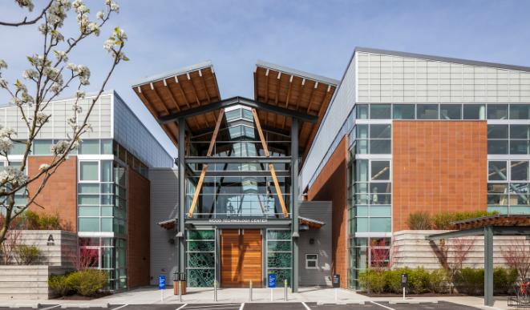
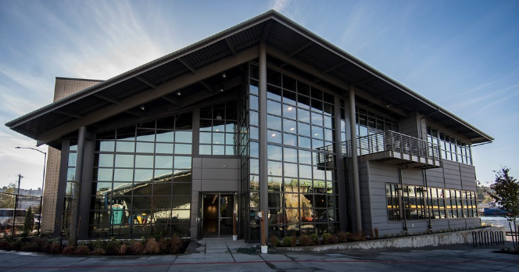
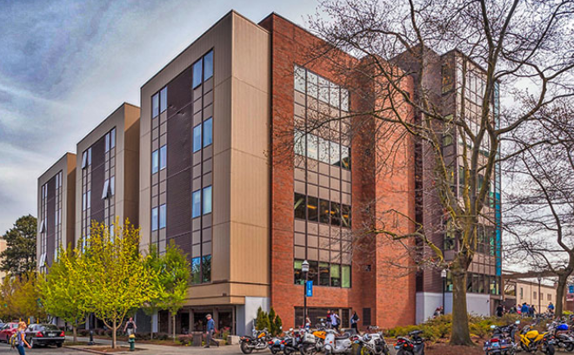
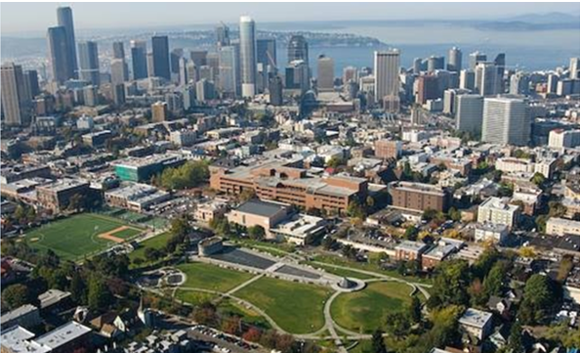


SEATTLE CENTRAL COLLEGE
Campus Budget Forum
Fiscal Year 2019-2020

Slide 2


The Big Picture
Instruction
International Programs
Parking
Foundation Funded
Professional Development
Grant Funded
Scholarships
Self Support & Enterprise
Student Services
Administrative Services
Institutional Management
Auxiliary Services – Food, Copy, Rent
National Science Foundation
Carl D. Perkins
WorkFirst
Operating Budget
Capital Budget
Minor & Major Projects
Repair & Program Improvement
M&O Funding
Department of Education
Notes:
Our focus is the operating budget. That is the vast majority of our budget, and that is what the state is cutting.
The Capital budget rises and falls each year, Capital funds can only be spent on capital items. The state sells tax free bonds that come with the IRS stipulation that they are spent on capital items, not salary.
Grants rise and fall annually and generally the grant provider stipulates that all the income is spent in pursuit of the grant goals, so those are break even at best.
The foundation donations are all driven by donor intent, so those are fixed.
Self support and enterprise funds are more flexible but a small fraction of overall revenue.

Slide 3
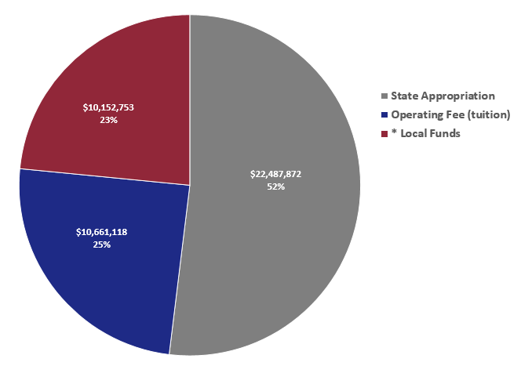
What are the sources of Operating Revenue ?
* Running Start, International Programs, Foundation, parking and other enterprises

Slide 4
Tuition “taxes” in 2019-2020
  3.5% Assistance to Needy Students
  3.37% (2.37% now) Innovation Account (ctcLink ERP Project)
  10.32% Building Fee
    Sent to State Treasurer, funds a portion of the colleges’ capital budget
  9.92% Service and Activity Fees
    Retained locally; used to fund student activities such as clubs, etc.
  Remaining 72.89% is retained.
Website: http://www.sbctc.ctc.edu/college/f_tuition.aspx
Notes:
Tuition deserves some elaboration.
People new to the system believe that you can multiply total FTE by tuition rates and come up with total income. 5138*4200= 21,579,600.
Three factors need to be taken into account.
First, 17% is ABE and many waivers. ABE tuition is $25/ QTR – very close to zero.
The discount is something like this: 5138-17% = 4264 fte = $17.9M
Second, 27% of tuition goes somewhere else. See slide.
The further 27% discount looks something like this: $17.9M-27% = $13.07M
This is just 60% of the theoretical maximum tuition collection.

Slide 5
Background
SCCC BUDGET PLANNING
INSTITUTIONAL/BUDGET CHALLENGES
  Declining Enrollment (state-supported FTEs)
  Tuition Shortfall
  Facility Conditions & Limitations
  Budget & Fiscal Constraints
  Decreasing International Student Enrollment
  Impacts from Past Budget Cuts

Slide 6
Background

Slide 7
Increased Costs
Background
Since 2009-2010 examples include:
  Inflation 17.5% since 2009
  ctcLink increase in 16-17 - $235,000
  Moore v HCA in16-17 - $556,000
  Unfunded COLA in 17-18 - $238,000
  Minimum wage law in 17-18 - $75,000
  District wide deficit in 17-18 - $197,000
  Unfunded COLA in 18-19 – est. $275,000
  Minimum wage law in 18-19 – ~ $10,000

Slide 8
Cost Increases: Lower Student Faculty Ratio
Background
Source: State Data Warehouse
Notes:
21/24.4 = 14% higher instructional effort to serve the same number of students.

Slide 9
Where does the money go?
Notes:
Internal sign post.
Sources of funds in the operating budget
where the money goes
The budget this year.
4. Budget planning for next year.

Slide 10
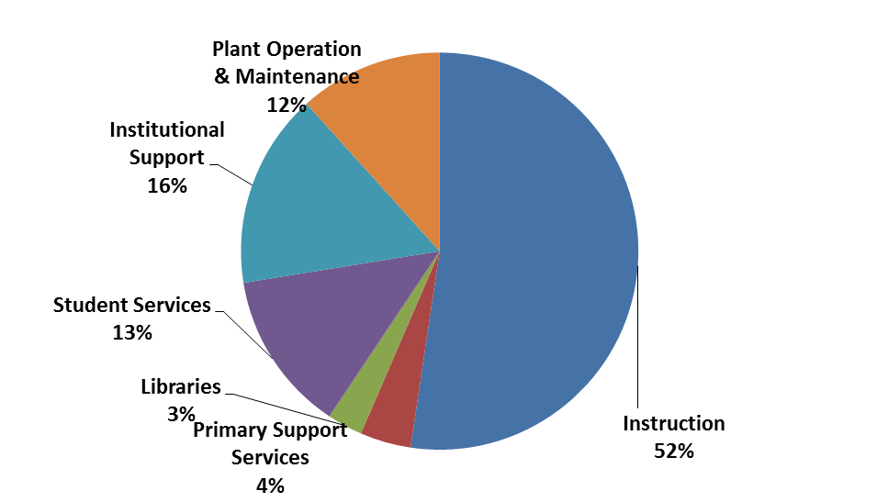
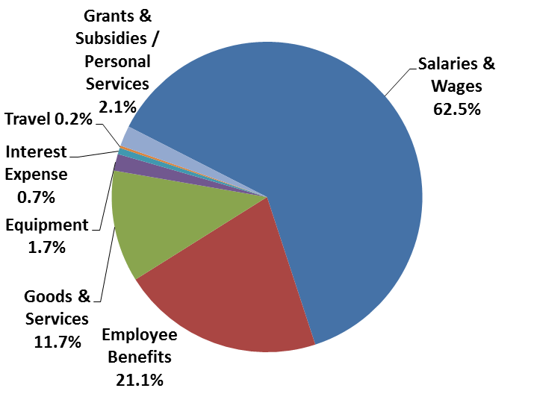
How SBCTC Colleges Spend their Money
General Fund State & Operating Fees
Expenditures by Program
Types of Expenditures
Notes:
This chart shows the data from colleges around the state.

Slide 11
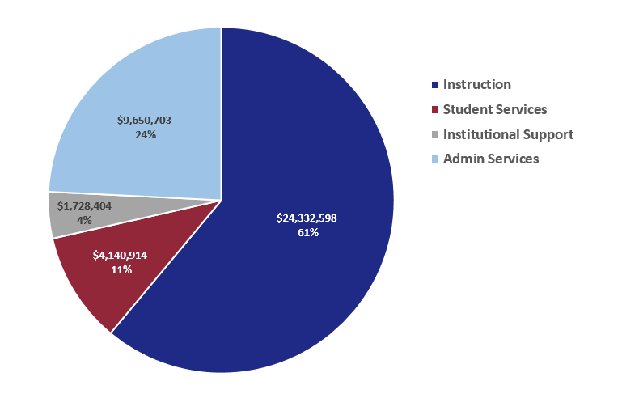
2017-18 SCC Expenditure by Cost Center
Notes:
This chart shows how SCC spent its money for the last complete academic year.

Slide 12
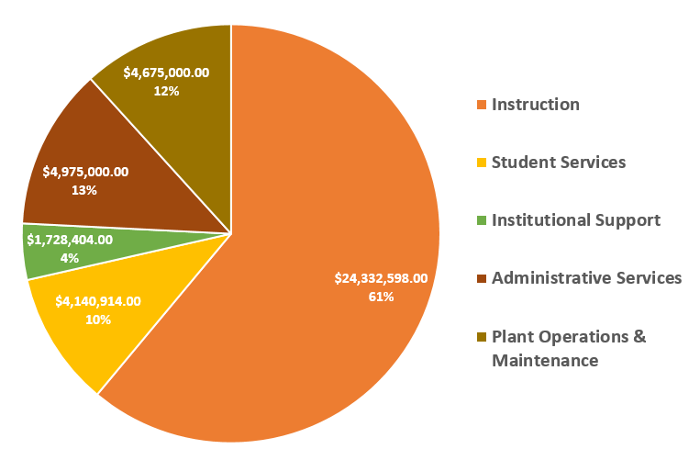
2017-18 SCC Expenditure by Cost Center
Notes:
This chart shows how SCC spent its money for the last complete academic year.

Slide 13
Cumulative Revenue Decline Since 2009-2010
Examples include:
New state allocation model cut to Seattle Central - -$1,444,000
Cost of declining enrollment
    State FTE income – -$3,999,168
    Tuition income (at 2019 rates after fees) - -$3,298,537
Portion of COLA’s unfunded by the legislature -$2,400,000
Notes:
The draft that clears gopher colonies due to the chimney on one hole being taller than the rest.
$3.6M increases
Reduction in AH spending 300,000 Dean of Extended Learning 100,000 Telephone savings 25,000 Increase in Running Start income 300,000 Transfer from Running Start to operating account to offset 200,000 Transfer from IEP to operating account to offset 95,000

Slide 14
Cost Increases: More Employees
Expense Increases

Slide 15
Background

Slide 16
The State Allocation MOdel

Slide 17


State Allocation Formula
  Minimum Operating Allowance (MOA)
  District Enrollment Allocation Base (DEAB=state FTE target)
  Student Achievement Initiative (SAI=performance funding)
  High priority (high demand) enrollment weighted FTE
  Provisos and earmarks
  Total District (College) Allocation

Slide 18


State Allocation Formula
  Minimum Operating Allowance (MOA)
  District Enrollment Allocation Base (DEAB)
  Student Achievement Initiative (SAI)
  High priority (high demand) enrollment weighted FTE
  Provisos and earmarks
  Total District (College) Allocation
E N R O L L M E N T

Slide 19
Use of Local Funds IN 17-18
Unfunded part of COLA- $590,000
New BAS program - $232,000
Heat loop flood on 3rd floor - $120,000
Energy Savings Project
– Lighting, Solar, Generator - $100,000
Counseling Center Remodel - $58,000
Furniture Clip - $38,000
Salaries and Benefits - $1,862,000

Slide 20

2019-2020
Budget Planning

Slide 21
2019 – 2020 Budget Year

Slide 22
YTY Changes
International enrollments down 12% - $2,000,000
Regional pay increases 5% and
3% pay ~$1,020,642
AFT faculty load adjustments - $100,000
ctcLink cash flow shortfall for 19-20
= 1% of tuition ~$800,000

Slide 23
SCC Budget Planning
  Proposed Legislative Budget includes:
    Regional pay increase of 5% and 3% salary increase
    Money for guided pathways ($200,000 plus DEAB share)
    Tuition increase of 2.2%
Notes:
House budget* includes:
Regional pay increase and 3% salary increase (65% - 75% funded)
Money for guided pathways ($1.5M for Central)
Nurse Educator Salary increase (perhaps $1.5M for the Seattle district)
Tuition increase of 2.2% (minus 1% for ctcLink)

Slide 24
SCC 2019 – 2020 Budget Planning
  Use reserves to offset reduced tuition & allocation
  Plan for budget 3% reduction in 19-20
      Increase revenue
      Increase efficiency
      Reduce costs
Notes:
House budget* includes:
Regional pay increase and 3% salary increase (65% - 75% funded)
Money for guided pathways ($1.5M for Central)
Nurse Educator Salary increase (perhaps $1.5M for the Seattle district)
Tuition increase of 2.2% (minus 1% for ctcLink)

Slide 25
SCC Budget Planning
  Potential New Revenue for FY 2019 - 2020
Year Up partnership – up to 300 FTE
BAS program enrollment growth
Increase average number of students per class
Divest old buildings to generate income
1.2% net tuition increase

Slide 26
SCCC BUDGET PLANNING
END OF PRESENTATION
QUESTIONS & ANSWERS

Slide 27

Ignore the rest of the content.
The remaining slides are just place holders.

Slide 28
local funds in the budget?
Seattle Colleges FY1819 Operating Budget Allocation
 |  | Total | Central | North | South | SVI | District-wide | Siegal
PERMANENT FUNDS
Above the Line (aka "the big pot"):
State |  | 46,313,629 | 12,610,075 | 9,349,189 | 11,125,751 | 1,300,947 | 5,112,452 | 6,815,216
Tuition |  | 29,433,146 | 8,811,028 | 6,532,551 | 7,773,887 | 999,923 | - | 5,315,758
FY 2018 Total Model Allocation ("big pot") |  | 75,746,775 | 21,421,102 | 15,881,740 | 18,899,638 | 2,300,870 | 5,112,452 | 12,130,974
College Specifically allocated items (State)
SAI |  | 3,003,603 | 1,178,629 | 874,467 | 950,507 | - | - | -
New Items & Program reallocations |  | 7,024,845 | 2,264,987 | 1,945,907 | 2,549,703 | 41,256 | - | 222,992
Ongoing Items |  | 2,782,495 | 1,154,452 | 623,582 | 999,182 | 5,279 | - | -
Compensation & Safe Harbor |  | 11,353,428 | 4,398,151 | 3,091,485 | 2,886,081 | 303,263 | 110,046 | 564,401
Sub-total |  | 24,164,371 | 8,996,219 | 6,535,441 | 7,385,473 | 349,799 | 110,046 | 787,393
College Specifically allocated items (Tuition / Indirect)
Additional Local Spending Authority |  | 24,680,167 | 12,399,441 | 7,384,515 | 3,896,211 | - | - | 1,000,000
Total Permanent Funds |  | 124,591,313 | 42,816,762 | 29,801,696 | 30,181,322 | 2,650,668 | 5,222,498 | 13,918,367
TEMPORARY FUNDS
New Items & Program reallocations |  | 989,319 | 325,685 | 404,248 | 259,386 | - | - | -
Ongoing Items |  | 897,205 | 125,000 | 474,913 | 297,292 | - | - | -
Compensation & Safe Harbor |  | - | - | - | - | - | - | -
Carryforward & other one time funds |  | 10,228,598 | 5,363,146 | 2,699,662 | 1,041,503 | 624,288 | - | 500,000
Total Temporary Funds |  | 12,115,122 | 5,813,831 | 3,578,823 | 1,598,181 | 624,288 | - | 500,000
TOTAL OPERATING BUDGET ALLOCATION |  | 136,706,435 | 48,630,593 | 33,380,519 | 31,779,503 | 3,274,956 | 5,222,498 | 14,418,367
Notes:
Net operating balance is referred to as “carry forward” in the district allocation document.

Slide 29
local funds in the budget?
Seattle Colleges FY1819 Operating Budget Allocation
 |  | Total | Central | North | South
PERMANENT FUNDS
Above the Line (aka "the big pot"):
State |  | 46,313,629 | 12,610,075 | 9,349,189 | 11,125,751
Tuition |  | 29,433,146 | 8,811,028 | 6,532,551 | 7,773,887
FY 2018 Total Model Allocation ("big pot") |  | 75,746,775 | 21,421,102 | 15,881,740 | 18,899,638
College Specifically allocated items (State)
SAI |  | 3,003,603 | 1,178,629 | 874,467 | 950,507
New Items & Program reallocations |  | 7,024,845 | 2,264,987 | 1,945,907 | 2,549,703
Ongoing Items |  | 2,782,495 | 1,154,452 | 623,582 | 999,182
Compensation & Safe Harbor |  | 11,353,428 | 4,398,151 | 3,091,485 | 2,886,081
Sub-total |  | 24,164,371 | 8,996,219 | 6,535,441 | 7,385,473
College Specifically allocated items (Tuition / Indirect)
Additional Local Spending Authority |  | 24,680,167 | 12,399,441 | 7,384,515 | 3,896,211
Total Permanent Funds |  | 124,591,313 | 42,816,762 | 29,801,696 | 30,181,322
TEMPORARY FUNDS
New Items & Program reallocations |  | 989,319 | 325,685 | 404,248 | 259,386
Ongoing Items |  | 897,205 | 125,000 | 474,913 | 297,292
Compensation & Safe Harbor |  | - | - | - | -
Carryforward & other one time funds |  | 10,228,598 | 5,363,146 | 2,699,662 | 1,041,503
Total Temporary Funds |  | 12,115,122 | 5,813,831 | 3,578,823 | 1,598,181
TOTAL OPERATING BUDGET ALLOCATION |  | 136,706,435 | 48,630,593 | 33,380,519 | 31,779,503

Slide 30
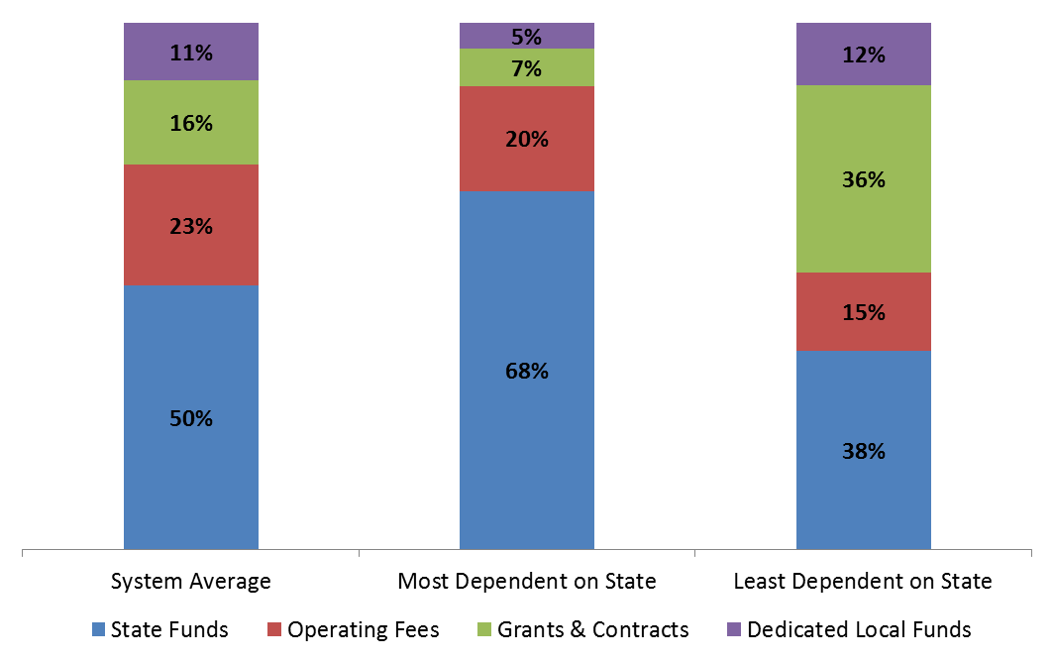
Community & Technical College
System Dependency by Fund FY 2011

Slide 31
Can we spend capital money on salaries?
“Not allowed:
• Regular staff operating costs
• Agency administrative costs related to capital budget development, capital facility development, long-range budget planning, and policy initiatives.
• Non-project specific tasks associated with regulation and policy development, contract development, interagency initiatives or legislative oversight.
• Non-project specific tasks associated with overall general comprehensive planning for facilities and infrastructure, the identification and prioritization of capital projects, and the preparation of agency capital requests.
• The provision of emergency services and infrastructure management. “
SAAM, chapter 4, page 12
http://www.ofm.wa.gov/budget/instructions/capinst/17-27capinstr/chapter4.pdf
Notes:
What do you do in the year after the capital funds are exhausted?
If the tax code allowed it and the colors of money could be mixed then the capital process and the operating budget allocation would be mixed and the buildings would suffer.

Slide 32
Budget Timeline
March
Business offices analyze and clarify all budget drafts
State revenue forecasts are due March 20th
April
Campus wide budget Forum with President
Chancellor and VCAS host district meetings at each campus
Preliminary SBCTC numbers published
May
President/ Chancellor finalize all budget decisions, pending the outcome of the legislative session.
Data in FMS updated and finalized
June
VCAS presents preliminary budget to the trustees for review
State revenue forecasts are due June 27th
State Budget finalized
July
SBCTC board must approve distribution after legislative budget settled (often July)
After distribution approved, SBCTC provides colleges ‘final’ initial allocation numbers
September
VCAS and VPAS present a final budget at September board meeting

