Slide 1

Global Solution – BPA Workshops
Foundation Proposal Review and Adoption
May 2, 2013
Thursday

Slide 2

Agenda
Welcome
Finance (FSCM)
Person Structure (HCM)
Bio-Demo Data
Search/Match
Closing

Slide 3
Morning Introductions
SBCTC
  Cindy Schaffer - Finance Team Lead
  Lisa Wolcott – Finance Team
Ciber
  Jerry Bitter - Finance Team Lead
  Art Flower - Finance Team
  Michael Holder - Finance Team
  Atul Sharma - Finance Team

Slide 4

Useful Terminology - FSCM
PeopleSoft Finance Terminology
  Chartfield
  Chartblock
  Required Chartfield
  Optional Chartfield
  Business Unit
  Global/Local Controls
  Tree

Slide 5
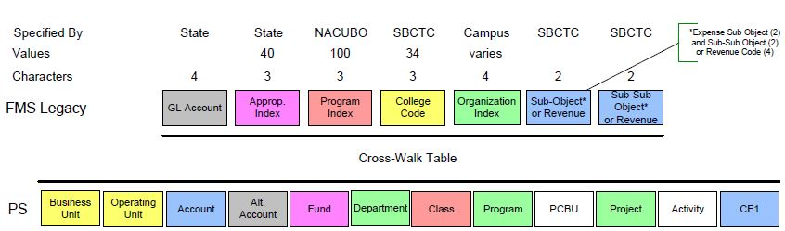
FSCM to PeopleSoft Mapping

Slide 6
PeopleSoft Delivered Chartfields
Business Unit
  General Ledger Business Unit. Typically this is established for each legal entity. This field is required for all transactions in PeopleSoft, and is usually automatically defaulted.
Operating Unit
  Used to identify a plant, office, physical location, branch, building, store, hospital, operations center, or geographic location.
  Usually related to responsibility reporting.

Slide 7
PeopleSoft Delivered Chartfields
Account
  Classifies the nature of the transaction. This field is required. Represents assets, liabilities and fund equity, as well as revenue and expense codes.
Alternate Account
  Classifies the nature of a transaction for regulatory authorities. Often used for statutory accounting.

Slide 8
PeopleSoft Delivered Chartfields
Fund Code
  The primary structural unit for College fund accounting.
Department
  Tracks information according to a divisional breakdown of the organization. Also indicates the responsible manager for the organizational unit.

Slide 9
PeopleSoft Delivered Chartfields
Class Field
  At SBCTC, targeted for NACUBO transaction category which is the legacy Program field. Used on expense transactions.
Program Code
  Can be used to identify groups of related activities, cost centers, revenue centers, responsibility centers and academic programs.

Slide 10
PeopleSoft Delivered Chartfields
PC Business Unit
  Associated with Projects module. Use as an operational subset of an organization to organize project activity independently of the constraints of the standard accounting procedures for the financial posting and reporting of the organization.
Project ID
  Sponsored Programs or Capital Projects code.

Slide 11
PeopleSoft Delivered Chartfields
Activity
  Associated with the Projects module. Activities are the specific tasks that make up a Project.
Chartfield1
  Generic expansion Chartfield is targeted for meeting District or Campus local requirements.

Slide 12
PeopleSoft Delivered Chartfields
Affiliate
  Used to map transactions between business units when using a single inter-unit Account.
Fund Affiliate
  Used to correlate transactions between Funds when using a single intra-unit Account.
Operating Unit Affiliate
  Used to correlate transactions between operating units when using a single intra-unit Account.

Slide 13
PeopleSoft Delivered Chartfields
Budget Reference
  Can be used to identify distinct budget periods associated with a Project. At SBCTC, we are considering this field for possible use as a Cost Share identifier.
Statistics Code
  Used to define statistical data, such as number of staff or square footage of space. Statistical Accounting only.

Slide 14
PeopleSoft Delivered Chartfields
Unused fields – subject to reassessment
  Product – manufacturing product
  Chartfield2 – generic expansion chartfield
  Chartfield3 – generic expansion chartfield
  Source Type – Projects transaction source
  Category – Projects cost category
  Subcategory – Projects cost sub-category

Slide 15
PeopleSoft Delivered Chartfields
Potential Use Fields – dependent upon module configuration
  Book Code
    Identifies subsets of ledger rows to segregate and maintain in the same ledger, various accounting, recording and reporting requirements for transactions in different accounting environments.
  Adjustment Type
    Used to define Adjustment Types associated with varying accounting treatments of prior period adjustments.

Slide 16
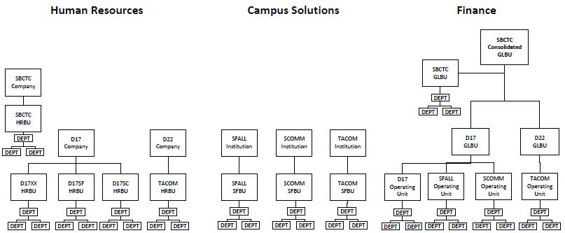
Financial Structure

Slide 17
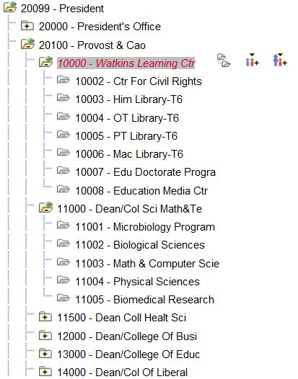
Department Rollup Tree

Slide 18
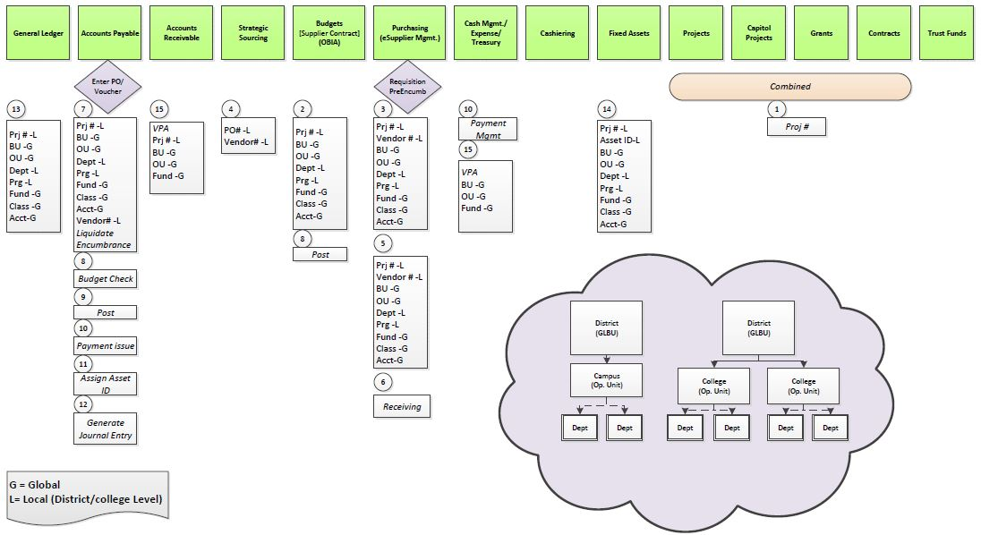
Financial Transaction Flow

Slide 19

Questions & Opportunities

Slide 20

Person Structure
Person Foundation
Person Attributes
Actions that create a Person
Person Types
  Employee
  Person of Interest (POI)
  Contingent Worker (CWR)
Empl ID Concept
Bio-Demo Data
Search/Match

Slide 21
Person Structure - Afternoon Introductions:
SBCTC
Kim Wasierski SBCTC – Financial Aid Lead
Ciber
Eric Davis Ciber – Time & Labor Lead
Connie Curd Ciber – HCM Benefits Lead
Judith Sternberg – CS Financial Aid Lead

Slide 22

Person Structure
Person Foundation
Person Attributes
Actions that create a Person
Person Types
  Employee
  Person of Interest (POI)
  Contingent Worker (CWR)

Slide 23
Person Structure
Empl ID Concept in Campus Solutions (CS)
Uniqueness
Empl ID is a key element for:
  Student
  Parent / Relationship
  Staff
  Faculty
  Alumni
Current system can have multiple SIDs
Notes:
In PS, the Emplid is unique for a person. The goal is to avoid duplicates at all costs. CS uses Emplid as a key element and not just for students – parents of PLUS loans, staff, faculty, etc.
In the current system, a student can have multiple Student IDs (SID) if they attended multiple schools.

Slide 24
Bio-Demo Data
Address Type
Name Type
Name Prefix
Name Suffix
Citizenship Status
Email Address Type
Phone Type
Ethnic Group
School Type
Relationships
Accommodation Type
Residency
Notes:
Reference Spreadsheet:
Address Type
Name Type
Name Prefix
Name Suffix
Citizenship Status
Email Address Type
Phone Type
Ethnic Group
School Type
Relationships
Accommodation Types
Residency – Setup SACR > Product Related > Campus Community > Define Campus Community > Setup > Residency Table

Slide 25
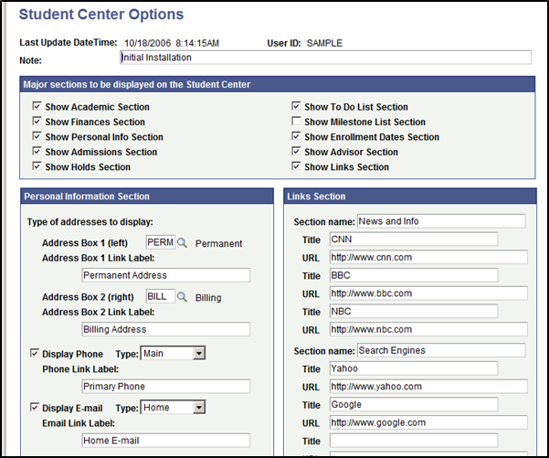
Bio-Demo Data
Self Service Student Center Setup:
What bio-demo types should be displayed in self service? Which bio-demo types will the student be able to change?
Options:
2 Address Types
1 Phone Type
1 Email Type
Notes:
Setup SACR > Common Definitions > Self Service > Student Center
There are only 2 address types, 1 phone type and 1 email type.
It is important to know which types the student will have access to update. Some areas will not use self entered data.

Slide 26
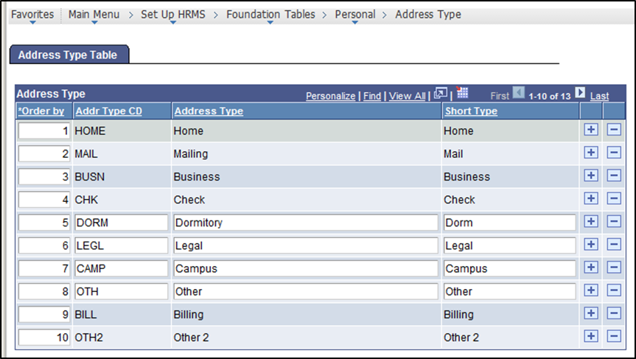
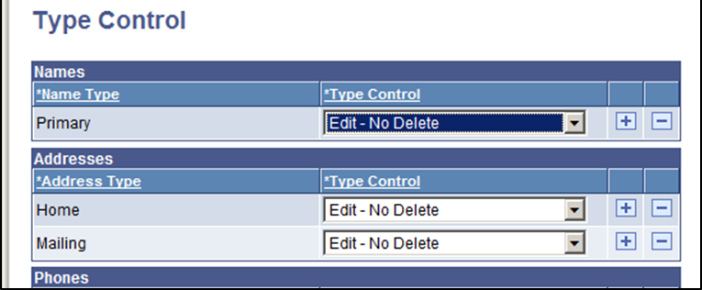
Bio-Demo Data
Address Type Setup
Type Control
Notes:
Address Type – Setup HRMS > Foundation Tables > Personal > Address Type
Type Control – Setup SACR > Common Definitions > Self Service > Type Control
Enter the address types to display in the Personal Information Section of the Student Center page. Only address types that are set up on the Type Control page as
Display Only,
Edit - No Delete, or
Full Edit are available.

Slide 27
Bio-Demo Data
Address Type
  Home
  Mailing
  Check
  Permanent
  Preferred
Email Address Type
  Business
  Campus
  Home
Phone Type
  Business
  Mobile
  Fax
  Home
  Campus
  Dormitory
Notes:
Address Type
Email Address Type
Phone Type

Slide 28
Bio-Demo Data
Name Type
  Primary
  Preferred
  Degree
  Former1
  Former2
  Legal
Residency
  In State
  Out of State
  International Student
Citizenship Status
  Native
  Naturalized
  Alien Permanent
  Alien Temporary
  Permanent Resident
  Employment Visa
  Canadian Citizen
  Other
  Not Indicated
Notes:
Name Type
Citizenship Status
Residency – Setup SACR > Product Related > Campus Community > Define Campus Community > Setup > Residency Table

Slide 29
Bio-Demo Data
Name Prefix
  Dr
  Ms
  Mr
  Mrs
  Rev
  Sister
Name Suffix
  II
  III
  IV
  V
  Jr
  Sr
  DDS
  RN
  PhD
Notes:
Name Prefix
Name Suffix

Slide 30
Bio-Demo Data
Ethnic Group
  Yaqui
  White
  Vietnamese
  Thai
  Spanish
  South American
  Filipino
  Native Hawaiian/Pacific Islander
  Etc…..
School Type
  Secondary
  Community College
  College
  University
  Vocational
  Vocational Education Training
  Etc…
Notes:
Ethnic Group
School Type

Slide 31
Bio-Demo Data
Relationships
  Brother / Sister
  Son / Daughter
  Father / Mother
  Guardian
  Loan Co-Maker
  Spouse
  Partner
  Etc…
Accommodation Types
  Telephone Induction Loop
  Accessible Entrance
  Add a Ramp
  Alternate Ground Access
  Repair Uneven Paving
  Handicapped Restrooms
  Audible Elevators
  Lower Elevator Buttons
  Adjusted Work Hours
  Etc…
Notes:
Relationships
Accommodation Types

Slide 32
Search/Match
Search/Match enables you to define search parameters that can be used to determine whether a potential duplicate person exists.
Global ad hoc search/match example. With 1 definition, it should accommodate all areas.
HCM search/match example
Existing system search/match (SMS and FAM)
PS Financial Aid ISIR Load search/match example

Slide 33
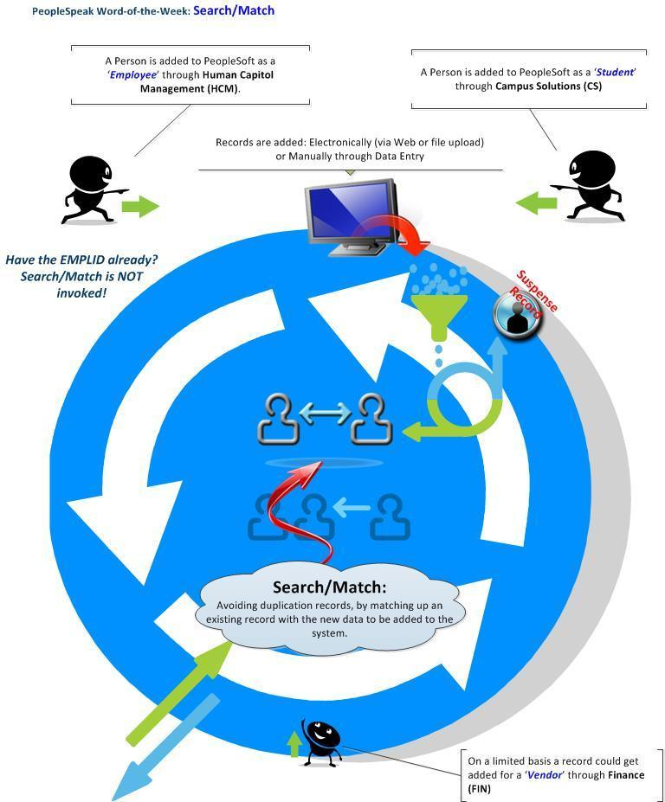
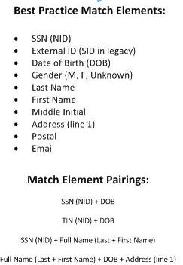
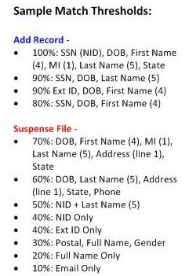
Search/Match
Notes:
In the PeopleSoft world every new person in the system, whether a student or employee, has a Person Record. This Person Record contains the traditional bio/demo data, such as name and address, but also contains other characteristics such as their relationship to the organization, their security, in the case of students their residency, driver's license information and ethnicity. You might hear some refer to this as the Person Model, which is simply a way of saying that each 'person' added to PeopleSoft, whether through Campus Solutions (CS) or Human Capitol Management (HCM) has information about them captured and stored in their Person Record. The Person Model is a term used to describe the information captured about a person and how the person is related to the organization. This model includes the core tables that are used by all products that are directly related to a person and their organizational relationships in the Enterprise HCM system.

Slide 34
Search/Match
HCM (Human Capital Management) uses 3 types of search/match rules:
Person (EMPL ID)
Applicant
Organization

Slide 35
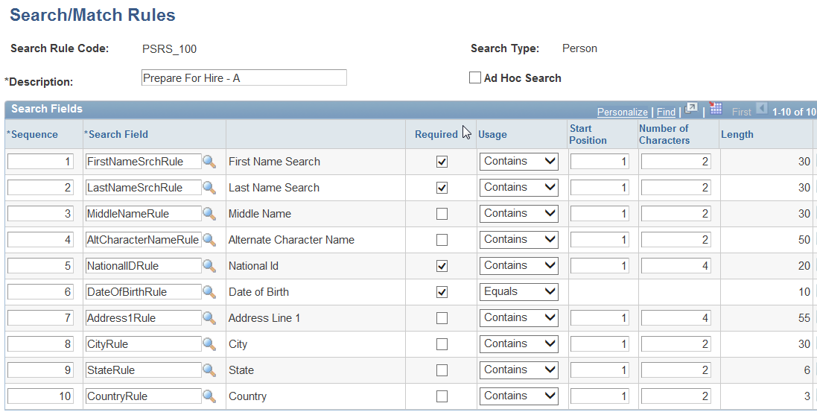
Search/Match
HCM Search/Match Example - Preparing for Hire

Slide 36
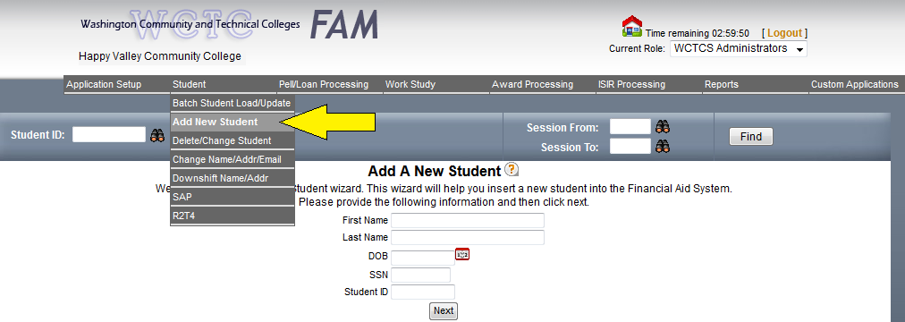
Search/Match
The current global student search/match between FAM and SMS:
Notes:
ADD NEW STUDENT: Enter student name and SSN (DOB and Student ID are optional). The process does a lookup on SSN in the SID-SSN-XREF-D data set in the SM database in the HP-UNIX.

Slide 37
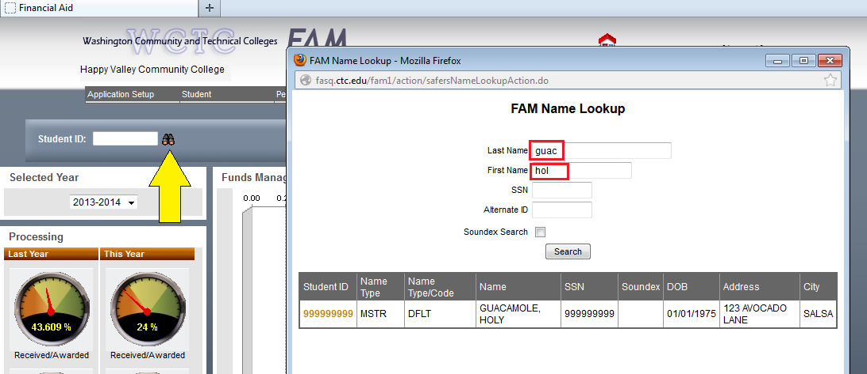
Search/Match
The current student search/match, FAM only:
Notes:
FAM NAME LOOKUP: Using the Student ID Lookup Icon, enter any combination (full or partial) of Last Name, First Name, SSN, and/or Alternate ID (i.e. SID).

Slide 38
Search/Match
What search elements are needed for a global ad hoc search? Best practice discussion results:
National ID (SSN)
External System ID (legacy IDs)
DOB
Gender (M, F or Unknown)
Last Name, First Name, Middle Initial
Address Line1 (street address)
Postal Code
Email

Slide 39
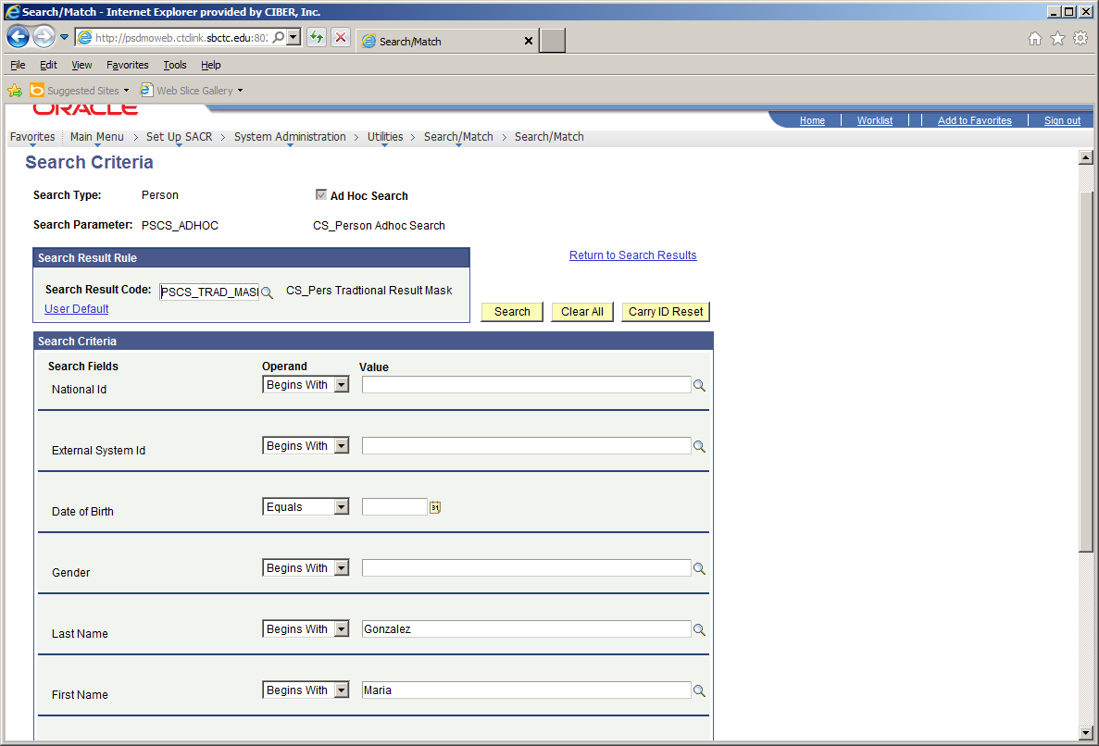
Search/Match
Global Ad Hoc Search/Match Example:
Notes:
Search Type = Person
Ad Hoc Search
Search Parameter = PSCS_ADHOC
Search Result Code = Shows the type of results returned – whether there should be masking on the NID or DOB
Search Criteria = all the search fields that are contained in the Search Parameter
Carry ID = when many IDs are returned, the one picked will be carried forward in the next pages accessed

Slide 40
Search/Match
Financial Aid uses 4 types of search/match rules:
Global Ad Hoc Search
ISIR Load Search
NSLDS Load Search
External Award Search
Notes:
An ad hoc search that is most global in order to find parents of students who are requesting a PLUS loan. The search must be performed before entering a new Emplid. This will be coordinated with all CS and HCM modules.
An ISIR load search which is very specific because the ISIR is a federal application and must match on SSN and other identifying criteria before loading. It is important to know what criteria the search found so as to be able to resolve the ISIR load efficiently.
A NSLDS load which is based on requests for student history or transfer monitoring alerts. Since these requests are sent already having a valid ISIR and the SSN and Emplid are verified, only a match on SSN is required.
An external award load which may contain student data for state awards or athletic grants. These files often are only keyed by SSN or perhaps an external student ID. The search rule is to be determined and must be flexible enough to weed out the students who are not yet Financial Aid activated so that step can be added in the process.

Slide 41
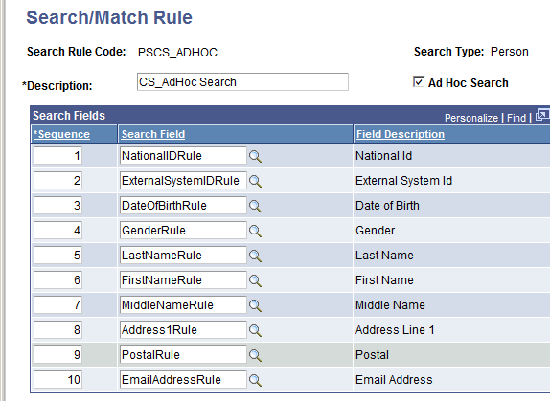
Search/Match - Global Ad Hoc Search
Notes:
Here is an example of an ad hoc search where there is no restriction on data entry of the search fields.
You can enter as many as you know, even with partial data and a list will come up for you to choose from or re-run with a narrower search.

Slide 42
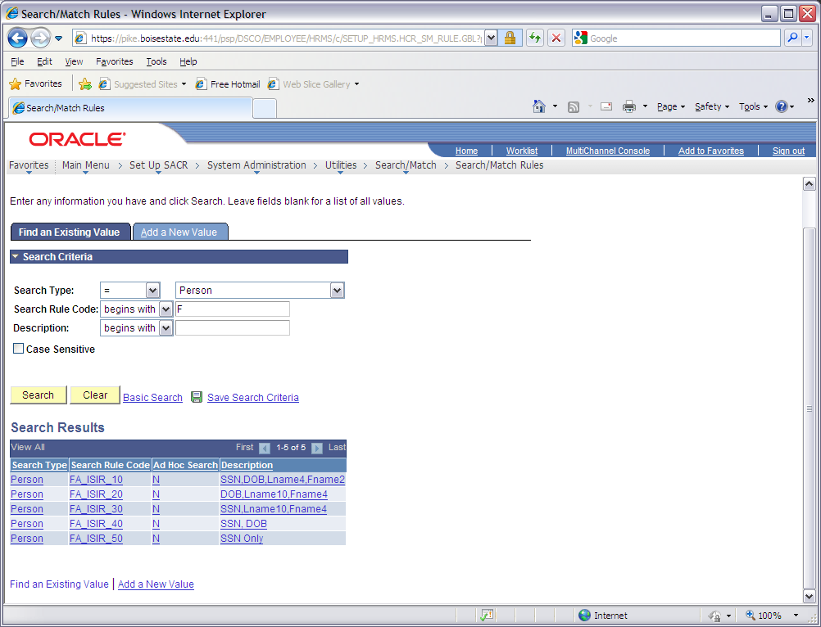
Search/Match
The ISIR load process search will use a 5 search rule setup.
Match level 10 is the only 100% match, but the Empl ID will be selected based on any of these matches.
The match level will tell you what is wrong:
If match level = 50, then no match on the DOB and name
If match level = 40, then no match on the name
If match level = 30, then no match on the DOB
If match level = 20, then no match on the SSN

Slide 43
Search/Match
Notes:
In the PeopleSoft world every new person in the system, whether a student or employee, has a Person Record. This Person Record contains the traditional bio/demo data, such as name and address, but also contains other characteristics such as their relationship to the organization, their security, in the case of students their residency, driver's license information and ethnicity. You might hear some refer to this as the Person Model, which is simply a way of saying that each 'person' added to PeopleSoft, whether through Campus Solutions (CS) or Human Capitol Management (HCM) has information about them captured and stored in their Person Record. The Person Model is a term used to describe the information captured about a person and how the person is related to the organization. This model includes the core tables that are used by all products that are directly related to a person and their organizational relationships in the Enterprise HCM system.

Slide 44

Useful Terminology
Empl ID – Employee ID, a unique identifier that stays with a “person”
External System ID – in CS this will house all the existing Student IDs
Alternate ID – in HCM, this will house the legacy SID.
NID – National ID or SSN for the USA
Notes:
The PeopleSoft ERP Solution​ uses a single identification number for all Person records, regardless of whether they are a student or employee. This number is universal across all colleges in the system. The number is not the Social Security Number (SSN), which is stored in the National ID (NID) field. The concept of the National ID number is because the PeopleSoft ERP Solution is a global solution that has been implemented at colleges and universities across the world.

Slide 45
Closing
Q&A Session
Wrap-Up
What’s Next

Slide 46

Questions and Answers

