Slide 1

Global Solution – BPA Workshops
Foundation Proposal Review and Adoption
May 1, 2013
Wednesday

Slide 2

Agenda
Morning session
  Global Design/Standardization
  Modules Overview
  Organizational Structure
Afternoon Session
  Academic Structure

Slide 3
Global Design
WACTC is implementing 3 pillars
  Human Capital Management (HCM)
  Campus Solutions (CS)
  Finance (FSCM)
Key data allows information to be shared among pillars
At the highest level, a global structure will be designed to work across all colleges
In addition, security structure will also be standardized across all colleges

Slide 4
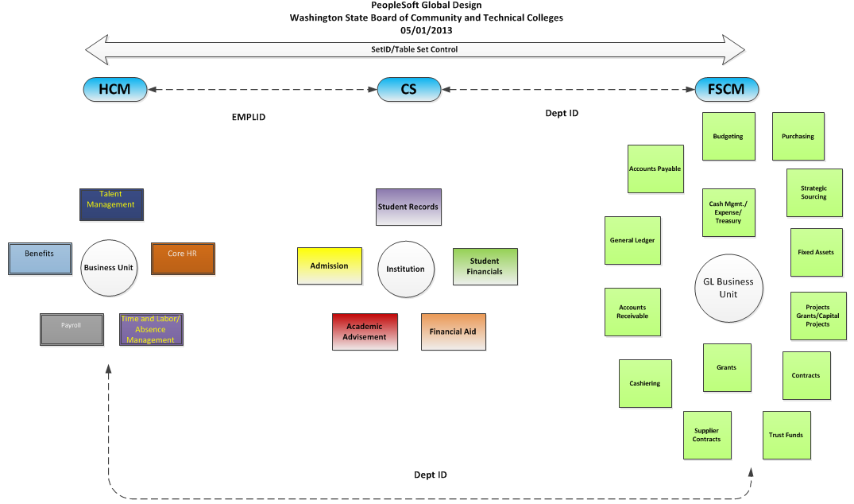
Global Design Across Pillars

Slide 5
Global Design – Human Capital Management (HCM)
Building blocks for Human Capital Management
  Company
  HR Business Unit
  Departments
The following slides illustrate 3 examples of organizational global structure
  Pierce College
  Seattle Central Community College
  Spokane College

Slide 6
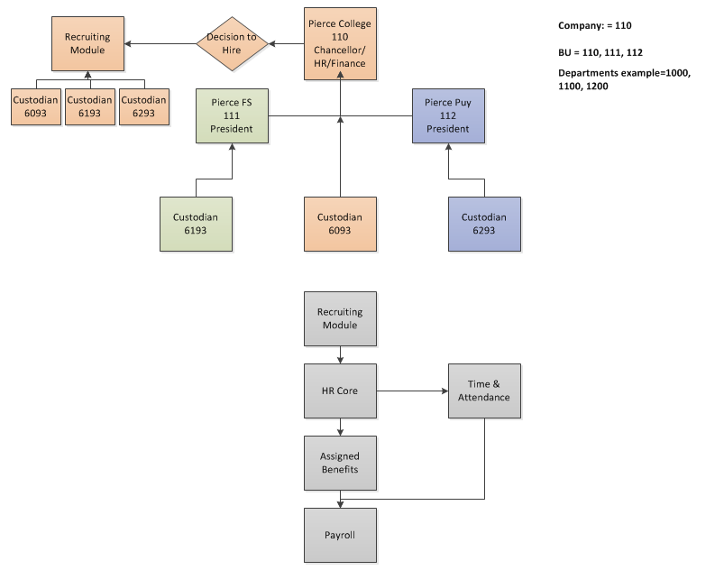
Global Design – HCM Pierce Example

Slide 7
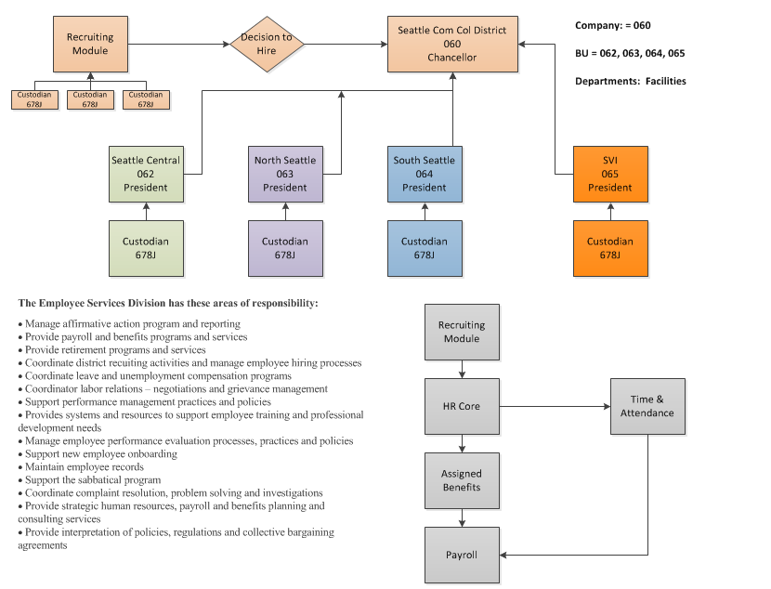
Global Design – HCM Seattle Example

Slide 8
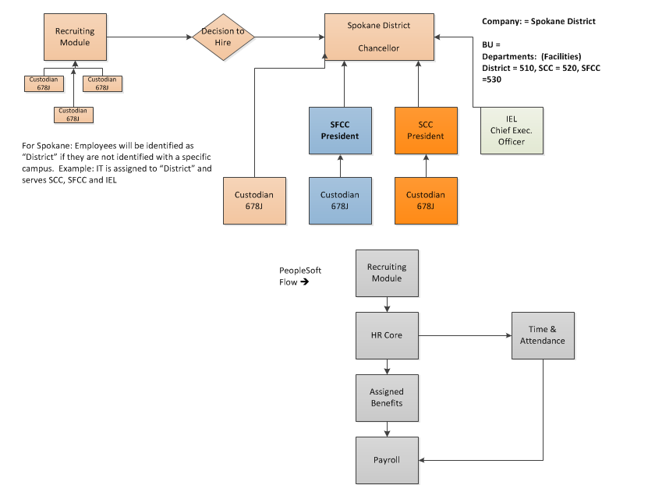
Global Design – HCM Spokane Example

Slide 9
Global Design – Campus Solutions (CS)
Building blocks for Campus Solutions
  Institution
  Academic Group
  Academic Organization
  Academic Career
  Academic Program
  Academic Plan
Global Design means that these building blocks need to be used in a standardized fashion across all colleges
The next few slides give an overall design and some examples

Slide 10
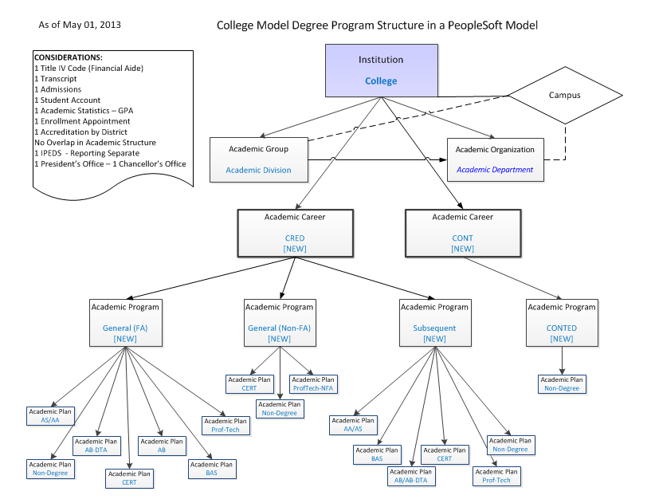
Global Design – CS (Concept)

Slide 11
Global Design – CS Examples
Shoreline Community College
Bellevue College
North Seattle Community College
Pierce College

Slide 12
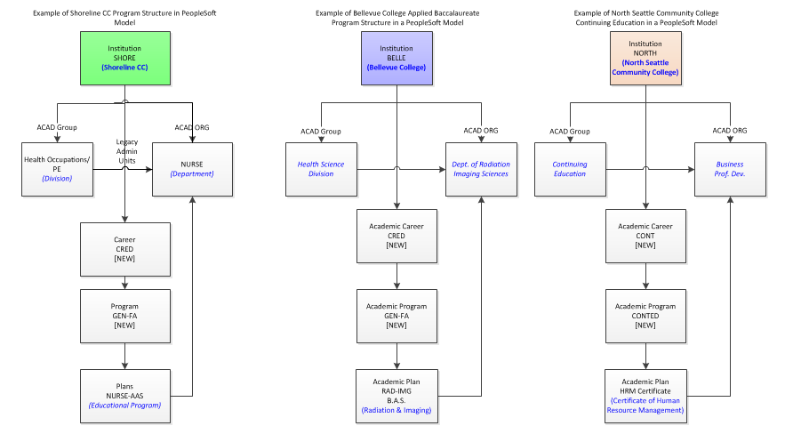
Global Design – CS Examples

Slide 13
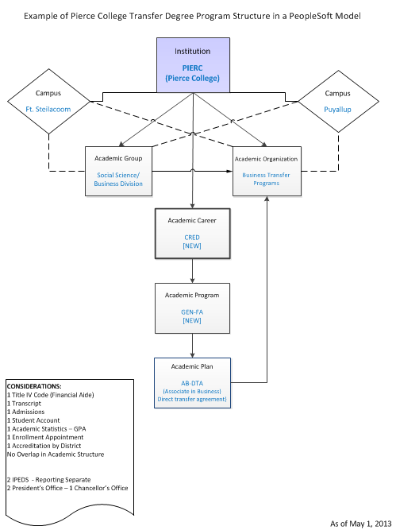
Global Design – Another CS Example

Slide 14
Global Design – Finance (FSCM)
Building blocks for Finance
  GL Business Unit
  Departments
  Operating Units
The following slides illustrate 2 examples of organizational global structure
  Seattle District
  Green River Community College

Slide 15
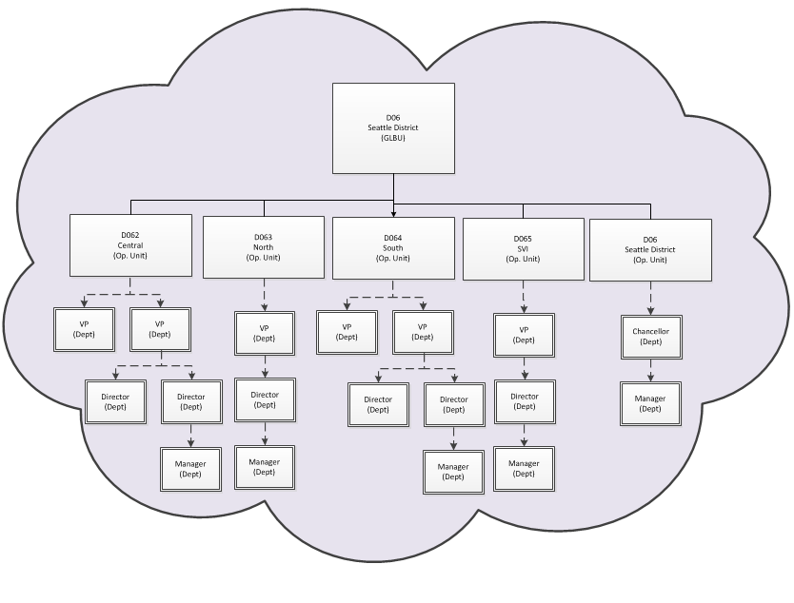
Global Design – FSCM Seattle Dist. Example

Slide 16
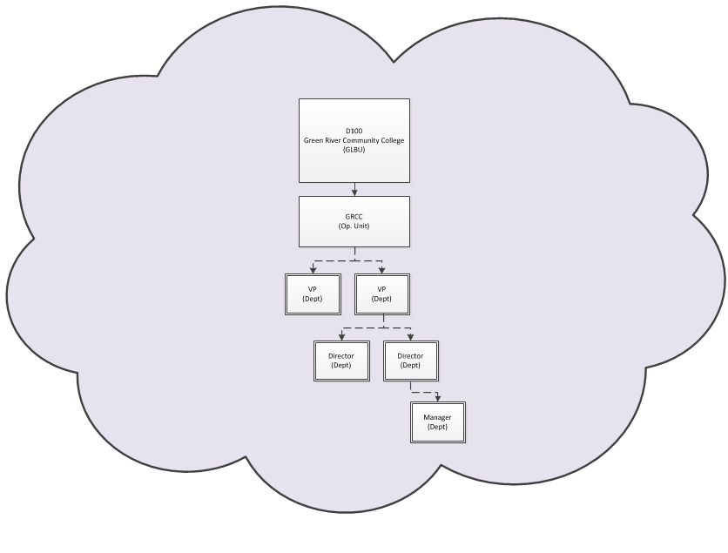
Global Design – FSCM GRCC Example

Slide 17
Global Design – Security
What is Role based security?
  Uses one or more roles and permission lists associated with the role
  Example: Role = Hiring Personnel
    Roles grant access to Permission Lists
    Permission Lists grant access to pages necessary to perform tasks
    May have add, update, correct, or view only access to the data on the pages depending on the permissions granted

Slide 18
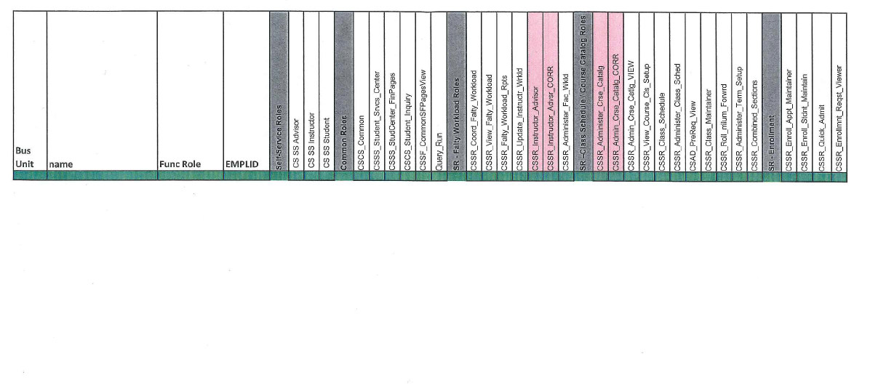
Global Design – Security
Security Matrix Example

Slide 19
Global Design – Security
Position: Cashier at College X
  Role 1:
  Base Student Financial
  Permission 1: View Customer Accounts
    Page: Customer Account (Read Only)
    Page: Account Details (Read Only)
    Page: Account Summary (Read Only)
  Permission 2: Student Self-Service View
    Page: Self-Service View (Read Only)
.
  Role 2:
  Base Cashier
  Permission 1: Open Cashier Office
    Page: Open Office (Update)
    Page: Open Cash Register (Update)
  Permission 2: Void Transactions
    Page: Void Transactions (Update)
Notes:
PeopleSoft ERP Solution is divided into three "pillars":

Slide 20
Global Design – Security
Definitions of roles and permissions will be standardized across colleges
BUT: A Cashier at College Y might have more or fewer roles, depending on responsibilities.
Notes:
PeopleSoft ERP Solution is divided into three "pillars":

Slide 21
PeopleSoft ERP Solution
Human Capital Management (HCM)
Campus Solutions
(CS)
Financial Management (FSCM)
Human Capital Management provides functionality to support Human Resources business processes and replaces our existing PPMS, as well as providing additional functionality around recruitment and talent management. In addition, online Self-Service access for employees.
Campus Solutions provides functionality to support Student Administration business processes. This replaces our existing SMS, FAM and Degree Audit, as well as our WTS system with online Self-Service access for students and faculty.
Financial Management provides functionality to support Financial business processes and replaces our existing FMS, as well as providing significant additional functionality in Supply Chain Management (purchasing).
Notes:
PeopleSoft ERP Solution is divided into three "pillars":

Slide 22
PeopleSoft ERP Solution
Human Capital Management (HCM)
Campus Solutions
(CS)
Financial Management (FSCM)
HR Core
Recruiting/Talent and Acquisitions Management
Payroll
Time and Attendance (Absence Management)
Benefits
Recruiting and Admissions
Student Records
Academic Advisement
Student Financials
Financial Aid
General Ledger
Accounts Payable
Accounts Receivable
Strategic Sourcing
Budgeting
Purchasing
Cash Mgmt./Expense/Treasury
Cashiering
Fixed Assets
Projects Grants/Capital Projects
Contracts
Grants
Supplier Contracts
Trust Funds
Notes:
Each of the 3 "pillars" contain a number of modules, such as the Student Financials module in CS, which replaces our current cashiering functionality for enabling student payment of tuition and fees.

Slide 23
Organizational Structure
Human Capital Management (HCM)
HR Core - Provides the foundation for your human resource management system
Recruiting/Talent and Acquisitions Management - A complete, integrated system that enables organizations to effectively manage workforce acquisition across all employment categories. Whether you have a few resumes to fill hard-to-find positions or you have plenty of resumes but top candidates are scarce, Talent Acquisition Manager is ideally suited to meet your needs in any type of hiring conditions. Streams of applicants can be screened, interviewed, and hired quickly and efficiently.
Payroll - Payroll for North America provides the tools to calculate earnings, taxes, and deductions efficiently; maintain balances; and report payroll data while minimizing the burden on IT managers and payroll staff.
Notes:
Human Capital Management (HCM), which provides functionality to support Human Resources business processes and replaces our existing PPMS, as well as providing additional functionality around recruitment and talent management. In addition, online employee self-service will be provided.

Slide 24
Organizational Structure
Human Capital Management (HCM)
Time and Attendance (Absence Management) –
  Absence Management enables organizations to automate the processes for planning and compensating paid time off for their workforce. It combines employee and manager capabilities and tracks all absences in a single application.
  Time and Labor facilitates the management, planning, reporting, and approving of time, and calendar and schedule creation and usage, from one global web-based application.
Benefits - When you implement PeopleSoft Benefits Administration, your first area of focus will be your benefit information. Using PeopleSoft terminology, benefit information includes programs, plan types, plans, rates, and calculation rules. All of this information is defined within the Manage Base Benefits business process in PeopleSoft Human Resources (HR).

Slide 25
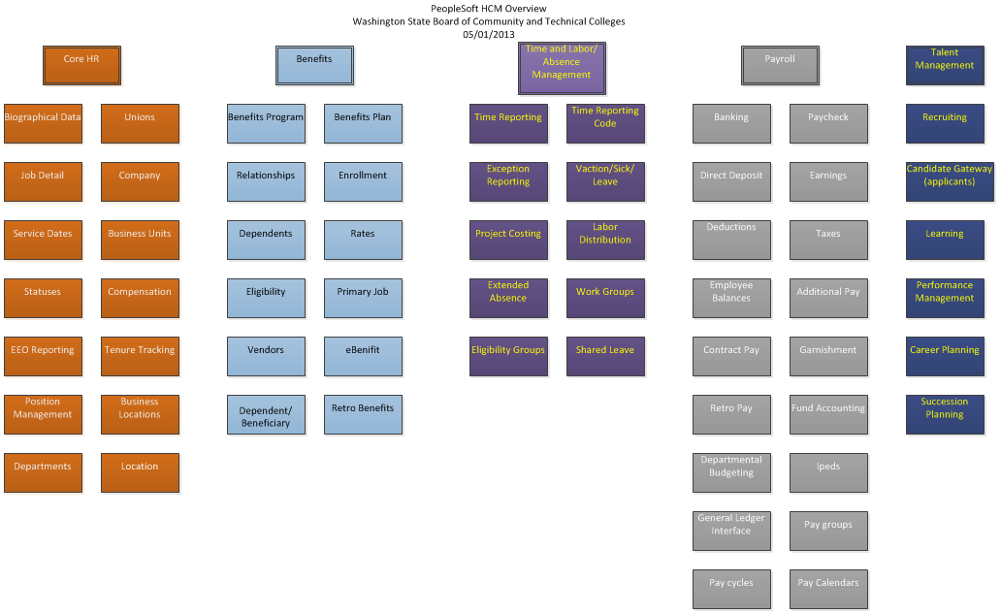
Organizational Structure – HCM

Slide 26
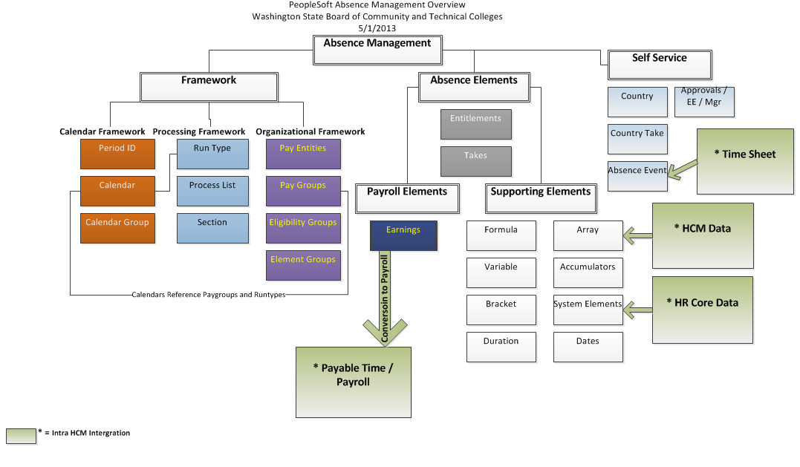
Organizational Structure – HCM

Slide 27
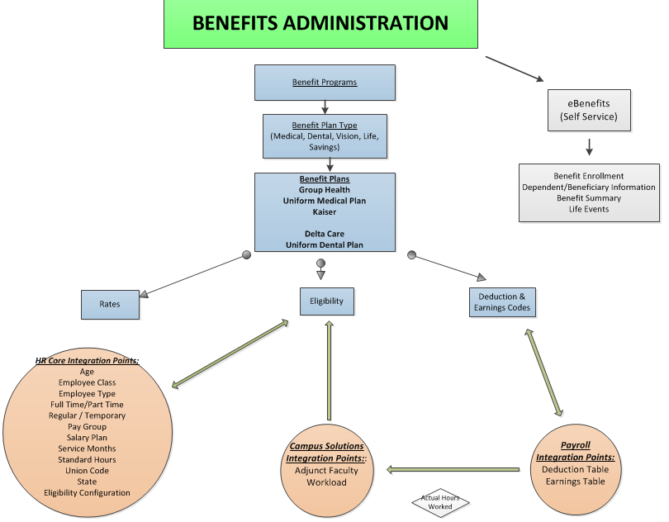
Organizational Structure – HCM

Slide 28
Organizational Structure
Campus Solutions (CS)
Recruiting and Admissions - Enables the institution to plan, manage and track its admissions and recruiting activities. Provides the capability to tailor the admissions process according to the requirements and practices of the institution. It also enables you to set enrollment targets , track progress toward recruiting efforts, and analyze admissions decisions and patterns.
Student Records - Enter, track, and process student academic and institution curriculum information; activate, enroll, grade, evaluate, and graduate students; create and maintain the course catalog and schedule of classes.
Academic Advisement - Provides the campus wide ability to define and track graduation requirements, configure Advisement reports, evaluate student degree progress, configure reports based on student degree progress, and convey requirements, policies, and procedures by analyzing the configuration of advisement rules and the student record.
Notes:
Human Capital Management (HCM), which provides functionality to support Human Resources business processes and replaces our existing PPMS, as well as providing additional functionality around recruitment and talent management. In addition, online employee self-service will be provided.

Slide 29
Organizational Structure
Campus Solutions (CS)
Student Financials - Enables the campus to manage and calculate student financial information. It provides functionality for billing and refunding student, as well as collecting past due balances. It provides functionality to set up payment plans for students. It also allows students to make payment online as well as through Cashiering.
Financial Aid - Support all awarding and disbursing functions. It will replace the existing FAM system and support all the regulatory release updates (4 Oracle Bundles each year). Financial Aid draws heavily on the other CS modules for data and coordination. There will also be an interface with HCM to support work-study students’ employment and earnings.
Notes:
Human Capital Management (HCM), which provides functionality to support Human Resources business processes and replaces our existing PPMS, as well as providing additional functionality around recruitment and talent management. In addition, online employee self-service will be provided.

Slide 30
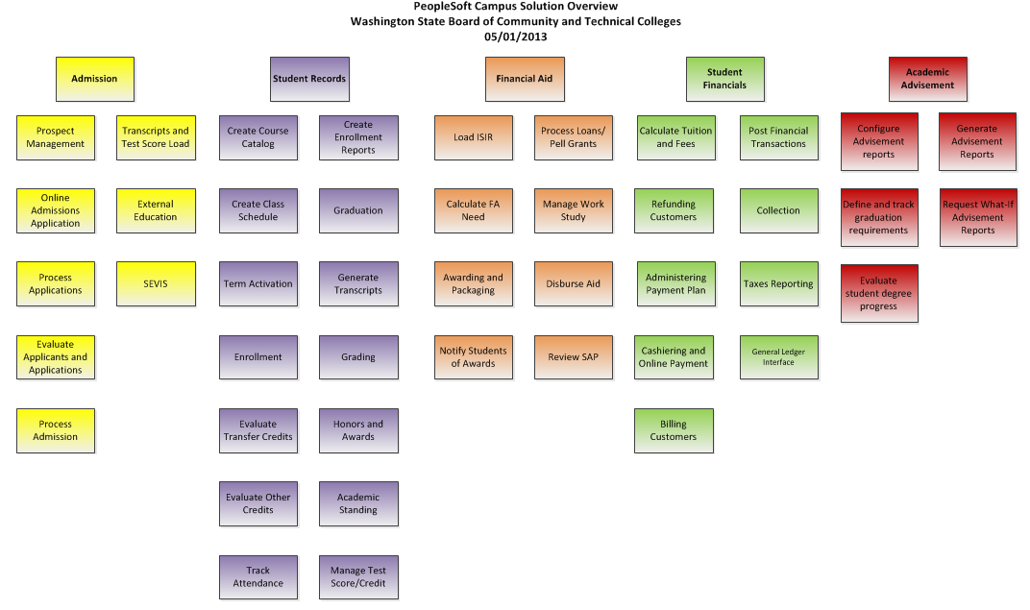
Organizational Structure – CS

Slide 31
Organizational Structure
Financial Management (FSCM)
General Ledger
Accounts Payable
Accounts Receivable/Billing
Strategic Sourcing
Budgeting
Purchasing
Cash Mgmt./Expense/Treasury
Cashiering
Notes:
Human Capital Management (HCM), which provides functionality to support Human Resources business processes and replaces our existing PPMS, as well as providing additional functionality around recruitment and talent management. In addition, online employee self-service will be provided.

Slide 32
Organizational Structure
Financial Management (FSCM)
Fixed Assets
Projects Grants/Capital Projects
Contracts
Grants
Supplier Contracts
Trust Funds
Notes:
Human Capital Management (HCM), which provides functionality to support Human Resources business processes and replaces our existing PPMS, as well as providing additional functionality around recruitment and talent management. In addition, online employee self-service will be provided.

Slide 33
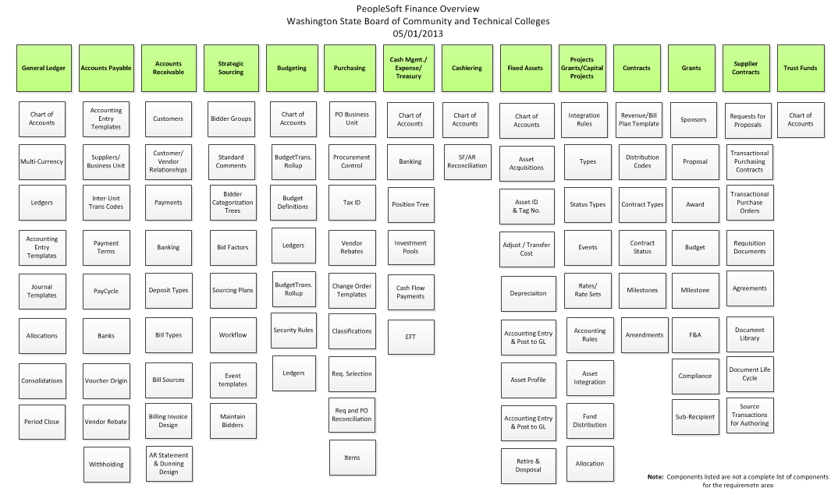
Organizational Structure – FMS

Slide 34

Organizational Structure

Slide 35
Afternoon Session
Academic Structure

Slide 36
Academic Structure Agenda
Goals of Foundations Decisions Session on Academic Structure
What is meant by Academic Structure?
What makes up Academic Structure?
Ancillary pieces to support Academic Structure
Does the global academic structure meet our requirements?
Questions and Answers

Slide 37
Academic Structure Session Goals
To get a high level overview of the components that make up Academic Structure (AS) in Campus Solutions
To get a “peek under the hood” at the Campus Solutions system with regard to Academic Structure functionality
To review the global design for Academic Structure, making sure the decisions being made meet the requirements as stated

Slide 38
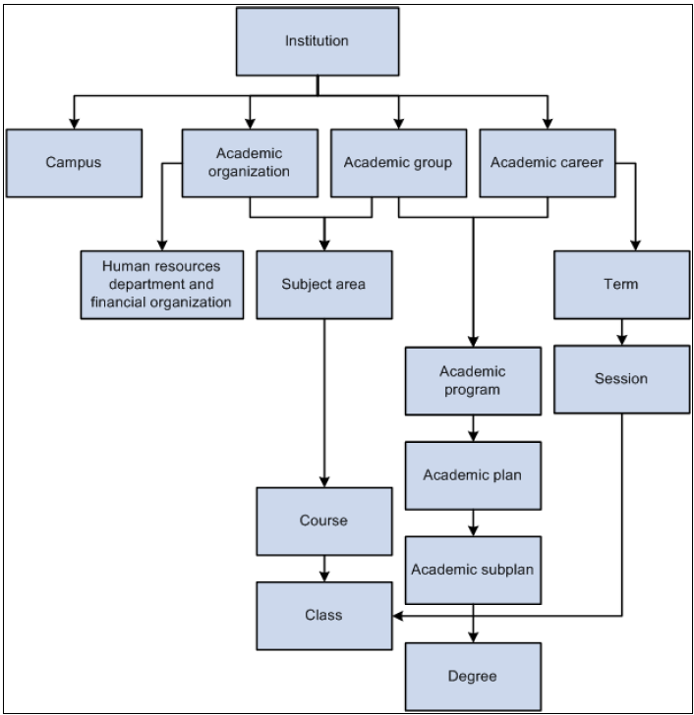
Academic Structure Defined
Academic Structure are the building blocks required for an academic institution (college or technical college)

Slide 39
Academic Structure - Components
Academic Institution
Campus
Academic Group
Academic Organization
Academic Career
Academic Program
Academic Plan
Academic Subject
Degrees
Academic Level
Academic Load
Academic Calendar
Academic Term
Academic Session
Grading Schemes
Facilities

Slide 40
Academic Institution
Academic Institution
An entity, such as a university or college, which runs independently from other like entities.
Each academic institution must have these characteristics:
  One Title IV code
  Individual admissions
  One student account
  Separate schedule of classes
  Independent transcript
  Independent academic statistics (GPA)

Slide 41
Campus
Campus
A campus is an entity, usually associated with a separate physical administrative unit, which belongs to an academic institution.
Campuses use the same course catalog as the institution and classes taken here appear on the same transcript as the academic institution.
A campus uses the same academic structure as the institution to which it is linked.

Slide 42
Academic Group
Academic Group
Academic groups are the highest level breakdowns of the academic institution for academic structural purposes.
Sometimes units such as extended education are defined as an academic group if classes are offered separately from the standard colleges or schools.
Academic groups are generally defined as the next level of academic organization structure below academic institution. However, academic groups can occur at any level within the academic organization structure
  not essential for academic groups to follow the same hierarchical structure as academic organizations.

Slide 43
Academic Organization
Academic Organization
Academic organization structure defines how an academic institution is organized from an administrative perspective. At the lowest level, an academic organization can be compared to an academic department. At the highest level, an academic organization can represent a division.
They are linked to one or more financial support or human resources departments on a percentage ownership basis.
  relationships are used to report, analyze, and distribute revenue and workload credit.
  Row level security is also associated with Academic organization via the Academic Org Security tree structure.

Slide 44
Academic Career
Academic Career
Academic career is used to aggregate all course work undertaken by a student at an academic institution; you group this course work in a single student record.
Academic careers have these common characteristics:
    • All credit is granted under a common unit type, such as semester hours or quarter hours.
    • A single repeat scheme is used.

Slide 45
Academic Program
Academic Program
In CS, students are admitted to not only the college, but to an Academic Program. The academic program controls the student's academic level, academic load, academic calendar, academic group for tuition calculation purposes, and grading scheme.
Academic Program is a layer of academic structure not currently existing in the legacy system. And, although it is called a ‘program’, it is not the same as legacy the Educational Program Code (EPC). The EPC is equivalent to the Campus Solutions Academic Plan (a subdivision of Academic Program).

Slide 46
Academic Plan
Academic Plan
An academic plan is an area of study—such as a major—that is within an academic program and academic career. The academic plan is a combination of the area of study (Radiological Sciences) and a degree type (A.A.S.) associated with the area of study.
Use academic plans to award degrees, indicate completion of the academic program, or award intermediate certificates or degrees.
Academic plans are ‘owned’ by academic organizations
Examples – AAS-Radiological Sciences; AB-Business

Slide 47
Academic Subjects
Academic Subject
Subject areas are the specific areas of instruction in which courses are offered within academic organizations.
Academic subjects are associated with an Academic Organization.
  Examples – MATH (MATH141), ENGL (ENGL101), RS (RS200)

Slide 48
Degrees
Degrees
Degrees are granted at the point the student completes his/her degree requirements.
Degrees are expressed as degree types and associate with an Academic plan, such as AAS (degree), Radiological Sciences

Slide 49
Academic Level and Load
Academic Level and Academic Load
Academic Level – Freshman, Sophomore, etc. – based on units successfully completed
Academic Load – Full time, part time, ¾ time – based on units enrolled
Various system processes use these rules to determine a student's academic level and academic load—processes such as class enrollment, financial aid reporting, and the consolidation of academic statistics for reporting.

Slide 50
Academic Calendar
Academic Calendars
Academic calendars define the landmark dates that drive much of the day-to-day business at the academic institution.
Academic calendars contains cancel, withdrawal, drop deadlines and other key dates
Academic calendars can be set up with static landmark dates based upon terms and sessions, or landmark dates can be dynamically calculated for individual classes.

Slide 51
Academic Terms and Sessions
Terms (Quarters) and Sessions
Terms and sessions are time elements used in conjunction with the academic calendar.
Term dates can affect class enrollment, financial aid, billing, tuition refunds, and statistical reporting.
Terms are linked to every academic career at the college
Sessions subdivide a term into multiple time periods in which classes can be offered
Sessions can have their own landmark dates for enrollment functions, census date, and begin/end dates, among others.

Slide 52
Grading Schemes
Grading Scheme
Typically, grade schemes are unique for each career
Grade schemes are made up grade bases
Grade bases are made up of individual grades
Grade bases are attached to courses
Example of a Grading Scheme – “Academic Grading Scheme”
Example of a Grading Basis – “Audit” or “Pass/Fail”
Example of grades within a Grading Basis
  “AUD” and “AUF” for “Audit” basis
  “P” and “F” for “Pass/Fail” basis

Slide 53
Facilities
Facilities
A facility is a combination of a building and a room where classes and events are commonly held
Facilities are assigned on the schedule of classes to denote where a class will take place

Slide 54
Global Design of Academic Structure
A walk through the requirements in need of foundation decision discussion.
Some requirements will not need discussion, as they are succinctly stated and have been researched fully
Examine how what we’ve captured during requirement validation has been designed to meet the needs of colleges and allow for discussion
A shallow dive into Campus Solutions

Slide 55

Questions and Answers

Slide 56

Questions and Answers

