Slide 1

Washington State Board for Community & Technical Colleges (SBCTC)
ERP Overview
Prepared for: WACTC Academy
April 29, 2011
Notes:
Placeholder for text of Conclusions, SPAs and others (substitute your own text)

Slide 2
Agenda
What will an ERP provide?
What won’t it do?
What are the benefits we can expect?
What can colleges expect?
What is the role of the President?

Slide 3
What will an ERP provide?

Slide 4
What will an ERP Provide?
Drivers
Student-centric service model
ERP Delivers
Enhanced Student Service
Process Streamlining
Compliance and Security Concerns
Competitive Advantage
Consistent View of Key Data: “Single View of the Truth”
Embedded ‘best practice’ business processes
Foundational application architecture and upgrade path for future releases
Challenges
Compete View of ALL Enterprise/Organizational Data
WCTC-wide Implementation and Execution of Common Processes
WCTC-wide Collaboration
Notes:
Key Issue: What are the drivers and inhibitors of an ERP II strategy?
Even as enterprises begin to shift their thinking to competing as part of a community of partners, the need to improve internal operations has never been higher. New rules of compliance (for example, Sarbanes-Oxley and CFR Part 11) have emerged to drive enterprises toward transparency. To fulfill compliance and the expectations of customer and suppliers in “Internet time,” access to enterprise data and processes must change dramatically. Exposing the right enterprise data and information previously has been poorly understood because of highly proprietary systems that were not easily integrated with enterprise applications. The transparency imperative will dictate greater visibility into enterprises and, ultimately, interaction with business constituents. Although ERP II assists with enterprise processes integration and exposure of the single data model, other issues emerge as enterprises find that ERP II vendors have not evolved to expose enterprise data and processes from applications from other vendors. Also at issue is the lack of enterprise execution of processes, because an ERP II strategy can enable enterprise processes, but enterprises must choose to re-engineer “siloed” processes.
Action Item: You can choose to begin to meet the transparency imperative with an ERP II strategy, but investments will be required to augment ERP II vendor technologies to achieve transparency.

Slide 5
What will an ERP provide?
Student
Student & Academic Records
Finance
General Ledger (GL)
Enterprise Mgmt
Reporting & Analytics
HR/Payroll
Recruiting
Recruiting & Admissions
Scheduling & Registration
Academic Affairs
Student Services
Financial Aid
Student Financials
Accounts Payable (AP)
Accounts Receivable (AR)
Asset & Inventory
Treasury (Cash Management)
Budget Devt & Position Control
Research & Project Accounting
Workforce Management
Payroll
Management Dashboard
Health & Safety Compliance
Document Management
Portal
Workflow

Slide 6
The World as we have known it
“As Is”
Systems targeting discrete business functions
Systems targeting common (simple) processes
“To Be”
Cross functional processes(internal & external)
End-to-end process support
All content types
Embedded Analytics
Modular but integrated

Slide 7
The World as we have known it
“To Be”

Slide 8
What will it not do?

Slide 9
What will it not do?
Not included:
Research
Data Analysis Software
Development Tools
Investigator Grants
Admin
Library
Library Info Systems
Content Databases
Virtual Libraries
Instruction
Content Dev’t
Distributed Learning
Academic Support
Instructional Management
Auxiliary
Point-of-Sale
Related inventory
Smart card
E-commerce

Slide 10
What are the benefits we can expect?

Slide 11
What benefits we can expect?
Improved level of service to students
Enhanced tools for faculty and staff at colleges and board level
Common, simplified processes
Consistency and integrity of data
Availability of Information and enhanced reporting capabilities
Foundation for future growth and evolution
Integration with other applications
Measurement of activity and project performance
Attraction and retention of employees
Lower application maintenance costs

Slide 12
What can colleges expect?

Slide 13
What can colleges expect?
New Systems
Different screens
New Processes
Different info coming from different places
Reduced steps in a process
New Responsibilities
Potential for delegated authorities
Different terminology
Different data to enter
Different reports
Different approval paths
Automated approvals
Different people entering data

Slide 14
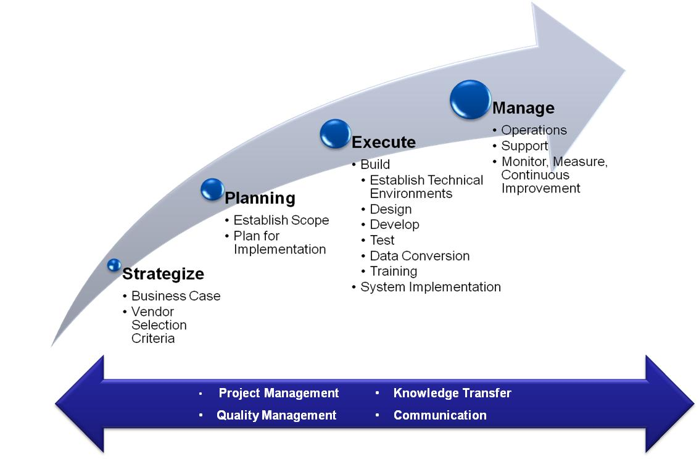
What can colleges expect ?
Page 13
Notes:
Key Issue: What are the drivers and inhibitors of an ERP II strategy?
Even as enterprises begin to shift their thinking to competing as part of a community of partners, the need to improve internal operations has never been higher. New rules of compliance (for example, Sarbanes-Oxley and CFR Part 11) have emerged to drive enterprises toward transparency. To fulfill compliance and the expectations of customer and suppliers in “Internet time,” access to enterprise data and processes must change dramatically. Exposing the right enterprise data and information previously has been poorly understood because of highly proprietary systems that were not easily integrated with enterprise applications. The transparency imperative will dictate greater visibility into enterprises and, ultimately, interaction with business constituents. Although ERP II assists with enterprise processes integration and exposure of the single data model, other issues emerge as enterprises find that ERP II vendors have not evolved to expose enterprise data and processes from applications from other vendors. Also at issue is the lack of enterprise execution of processes, because an ERP II strategy can enable enterprise processes, but enterprises must choose to re-engineer “siloed” processes.
Action Item: You can choose to begin to meet the transparency imperative with an ERP II strategy, but investments will be required to augment ERP II vendor technologies to achieve transparency.

Slide 15
What can colleges expect?
A communication and coordination structure will be developed (similar to Lift and Shift) to ensure colleges have a direct communication link to the project. A recommended structure will be included in the project charter.
Varying degree of involvement of staff during the implementation depending on the desired level of commitment to the design and implementation of the solution
Requirement to initiate and manage change to the business processes, roles and responsibilities, and, potentially organizational model
Requirement to backfill positions where staff have been appointed to the implementation team
Staff’s participation in testing and training effort

Slide 16
A Focus on the Readiness Assessment Will Ensure SBCTC Is Prepared For The People Side Of An ERP Initiative
Project Preparation Checklist
Commit to common vision and business case
Supplement team weaknesses with external hires or services
Define and implement project governance structure
Create Change Management Program
Determine and execute resource backfill strategy
Secure/build out team facilities
Initiate data cleansing analysis
Develop Enterprise Architecture Strategy
Refine project budget
Finalize solution implementation strategy and project plan
Typical breakdown of investment for similarly scoped ERP Projects
5-10%
5-10%
10-25%
20-25%
65-75%
65-75%
Hardware
Software
People

Slide 17
ERP Systems Overview (Examples) Implementation Approach Is Driven by Scope of Change
Implementing new “best”
practices
Removing non value-added activities
from processes
e.g., activity-based analysis, procurement cards, workflow
e.g., move from three-way matching to payment on receipt
Standardizing nomenclature / data across the enterprise
Restructuring where processes
get done
e.g., common chart of accounts
e.g., shared services

Slide 18


Description of Participants
Functional Experts
Admissions / Enrollment
Registrar
Bursar
Academic Advising
Faculty
Financial Aid
Process Integration
Organization Change Mgmt
Training
Reporting / Information Access
College Representatives
Functional
Curriculum
Faculty
Academic Advising
Process
Organizational Change Mgmt
Project Sponsors
Business Sponsor
IT Sponsor
College Presidents
Steering Committee Members
Trustees
Technical Experts
Architecture
Development
Data Migration & Integration
Security
IT Operations

Slide 19
What is the role of College Presidents?

Slide 20
What is the role of the President?
Executive champions within the respective colleges
Facilitate communications throughout the college to trustees, students, faculty and staff
Support decision-making with respect to implementation approach, best practice adoption, training, etc.
Collaborate with other colleges to achieve common processes, implement best practices and enable “board-wide” reporting and analysis
Appoint delegates to project steering committees, and implementation teams where appropriate

