Slide 1
BUDGET 102
A Brief on Compliance
(the rules that guide our work)
presented by
Seattle Central Business Office

Slide 2
Seattle Colleges District is a
GOVERNMENTAL ENTITY as part of the CTC System

Slide 3
As such,
WE are all STEWARDS of
PUBLIC RESOURCES!

Slide 4
And, we have at least one rule for everything we do!
(sometimes more than one :-)

Slide 5
The Big Picture
RCW
SAAM
WAC
FAM
DISTRICT POLICIES

Slide 6
REVISED CODE OF WASHINGTON (RCW) is STATE LAW – a compilation of all (permanent) laws currently in force in Washington State.
http://apps.leg.wa.gov/rcw/
WASHINGTON ADMINISTRATIVE CODE (WAC) – WACs are rules adopted by agencies to enact legislation and RCWs.
http://apps.leg.wa.gov/wac/

Slide 7
STATE ADMINISTRATIVE AND ACCOUNTING MANUAL (SAAM) – the rules we live by under OFM.
https://www.ofm.wa.gov/accounting/saam
FISCAL AFFAIRS MANUAL (FAM) – the ground level guidance written and compiled by subject matter experts across our CTC system – our ‘go to’ reference.
https://fam.sbctc.edu/

Slide 8
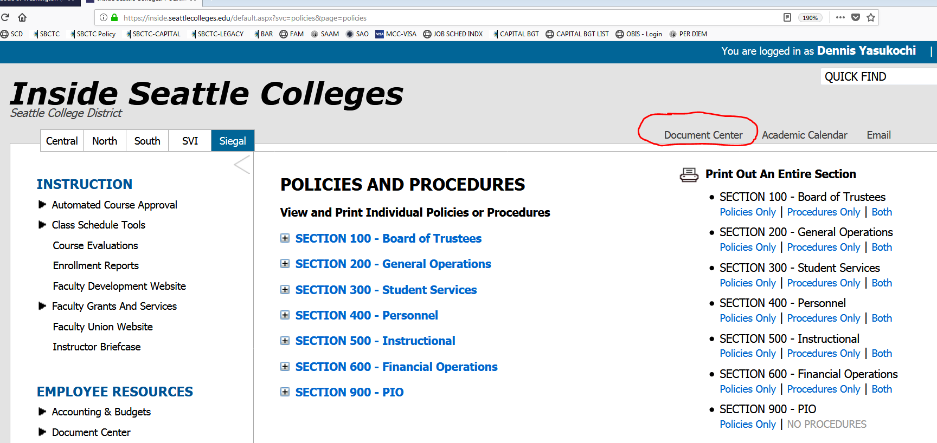
SEATTLE COLLEGES DISTRICT POLICIES AND PROCEDURES –
our district’s own rules.

Slide 9
Plus – FEDERAL LAW!
GRANTS,
FINANCIAL AID,
TITLE IX,
Etc.

Slide 10
Rules of Thumb:
Hierarchically speaking, Federal law (rules) trumps all.
Our district can be more restrictive than federal or state rules, but not less, in its rule making.
Public Perception matters!

Slide 11
The Bigger Picture
FEDERAL LAW
RCW
SAAM
WAC
FAM
DISTRICT POLICIES

Slide 12

Compliance Resources

Slide 13

State of Washington
Revised Code of Washington (RCW)
  Where to find it?
  http://apps.leg.wa.gov/RCW/default.aspx?cite=28b.50
  RCW Specific to Higher Ed: Title 28B
Washington Administrative Code (WAC)
  Where to find it?
  http://apps.leg.wa.gov/wac/default.aspx?cite=132F
  Seattle Colleges Specific WACS: Title 132F
What’s the difference? RCW are statutes, passed by the state legislature or by vote of the people. WAC are administrative regulations, or rules, adopted by state agencies.
Notes:
RCW are statutes, passed by the state legislature or by vote of the people. WAC are administrative regulations, or rules, adopted by state agencies

Slide 14
Office of Financial Management (OFM)
State Administrative & Accounting Manual (SAAM)
  http://www.ofm.wa.gov/policy/contents.asp
  Administrative policies that provides guidance on:
    Accounting guidelines
    Travel
    Light Refreshments
    Contracts
    Payroll
    Inventories
    Capital assets

Slide 15

State Board of Community and Technical Colleges
(SBCTC)
Fiscal Affairs Manual – FAM
  https://fam.sbctc.edu/
  Provides guidance on financial reporting
    Chart of accounts
    Budgeting
    Asset management
    General administrative policies

Slide 16
SCD Policies & Procedures
General Operations
Student Services
Personnel
Instructional
Financial Operations
Go to https://inside.seattlecolleges.edu/logon/default.aspx?ReturnUrl=%2f
Login with your username and password
Click on “Policies/Procedures” on the left hand panel

