Slide 1
Welcome to
BUDGET 101 presented by
Seattle Central College Business Office

Slide 2
Where we’ll take first steps in learning to read a
BUDGET REPORT!

Slide 3
To do this, we need a general sense of something called ….

Slide 4
“Fund Accounting”
- its concepts, as an overriding system -

Slide 5
AND – very importantly, we’ll begin developing an understanding of the .…

Slide 6
“Account Structure”
(this is literally the key
to all fiscal reports)

Slide 7
Fund Accounting
Accounting records are how we keep track of what we do with money.

Slide 8
Fund Accounting is a method of organizing the accounting records by collecting them into
Accounting Containers called “Funds”.

Slide 9
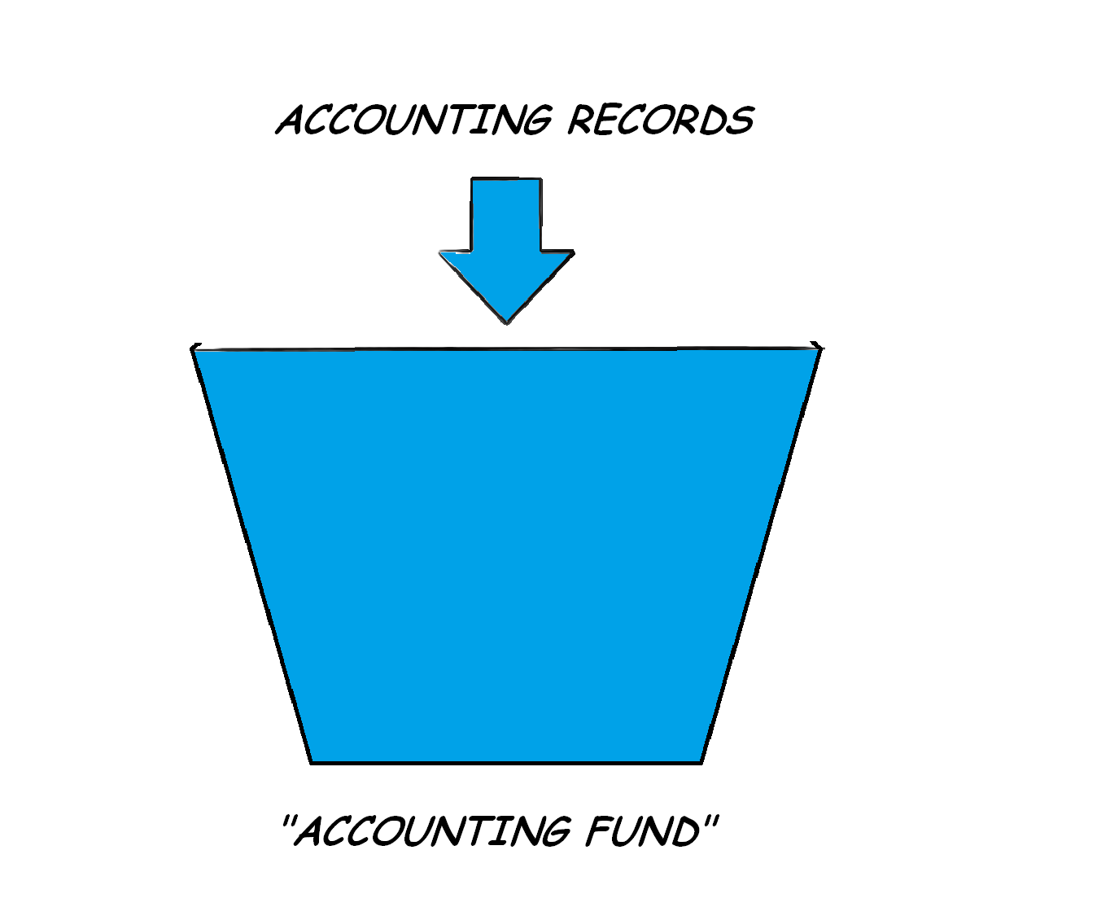
Thinking of an Accounting Fund as a container is a pretty accurate way of visualizing it

Slide 10
There is a FUND for each type of thing we do:

Slide 11

Notice that each fund has a numeric identifier.

Slide 12
A brief “Big Picture” moment:
Legislature, OFM, SBCTC, CTC, SCD, SCC

Slide 13
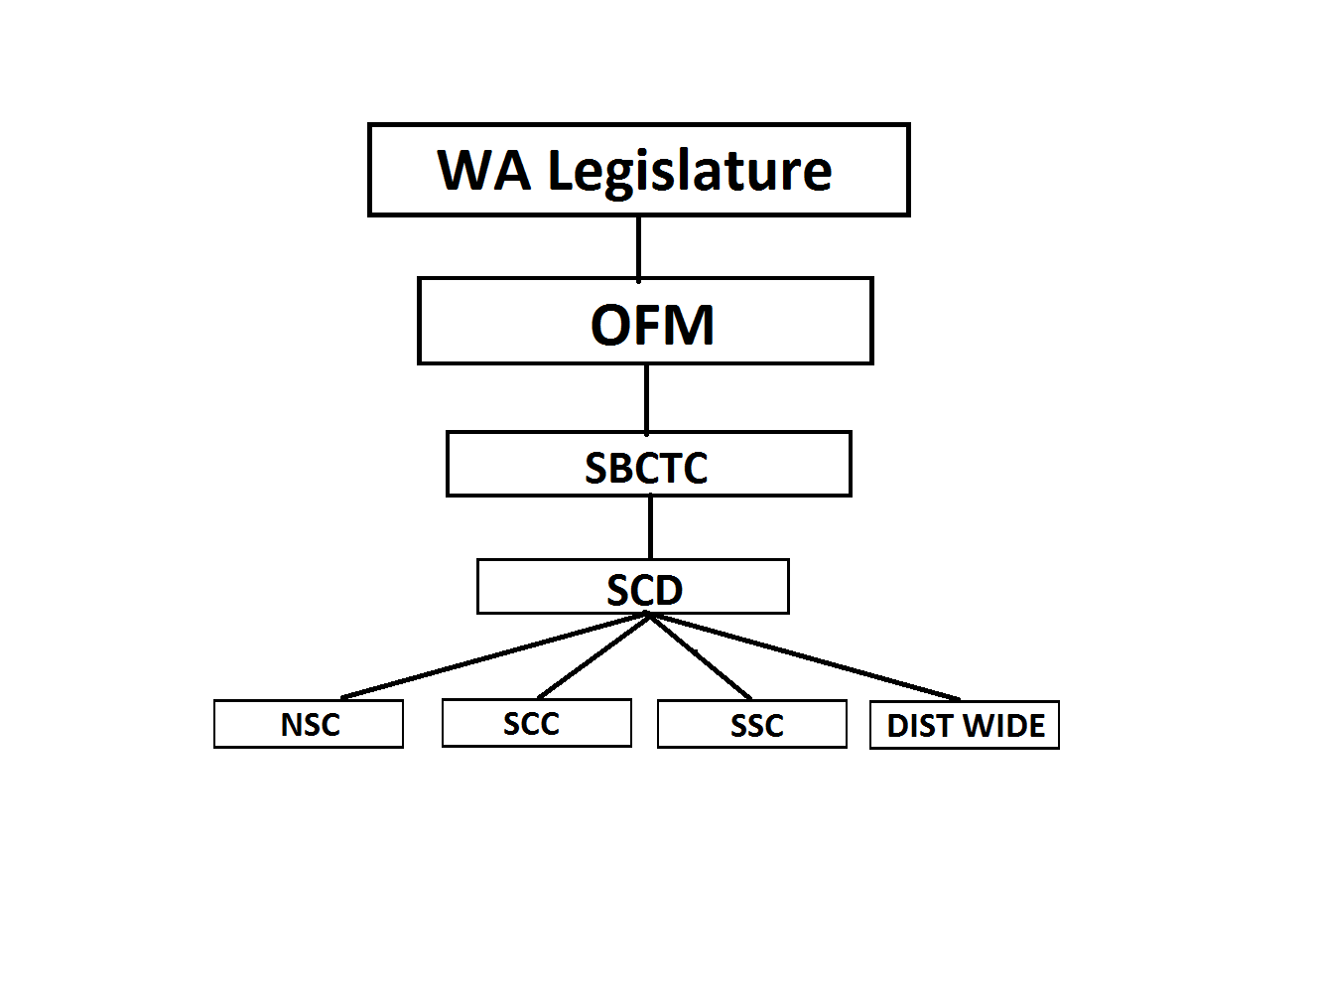

Slide 14
We’ll come back to the concept of Funds when we discuss the Account Structure.

Slide 15
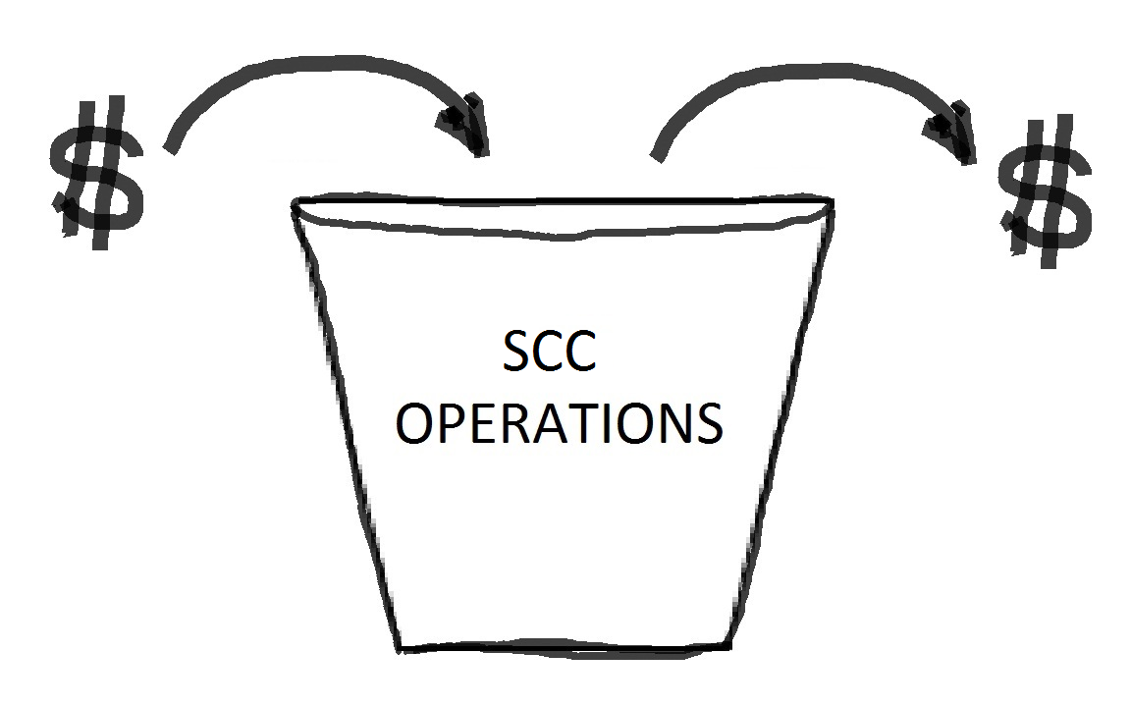
Money In, Money Out

Slide 16
MONEY IN: State Appropriations, Tuition, Fees, Grants, Gifts, etc
MONEY OUT: Payroll, Purchases of Various Goods, Services, etc
MONEY NEUTRAL: Transfers between SCC departments (money neutral to the college as a whole).
MONEY IN: is generally called REVENUE OR REIMBURSEMENT
MONEY OUT: is generally called EXPENDITURE
MONEY NEUTRAL: is generally called INTERDEPT TRANSFERS

Slide 17
To make a PLAN for money movement,
we CREATE a BUDGET
When money MOVES (in, out, neutral)
we CREATE an TRANSACTION
When each Transaction HAPPENS,
we must CREATE an Accounting RECORD

Slide 18
ACCOUNT STRUCTURE
(working definition)
“The framework underlying our method of using numbers and letters to record what we do with money.”

Slide 19
ACCOUNT STRUCTURE
It is difficult to overemphasize the importance of understanding the Account Structure – it is the key to understanding Budget Reports.

Slide 20
By design, both our Budget system and
our Accounting system
employ the same
Account Structure Methodology
(as does the entire CTC System)

Slide 21
Primary Account Structure Elements
& Their Abbreviations

Slide 22
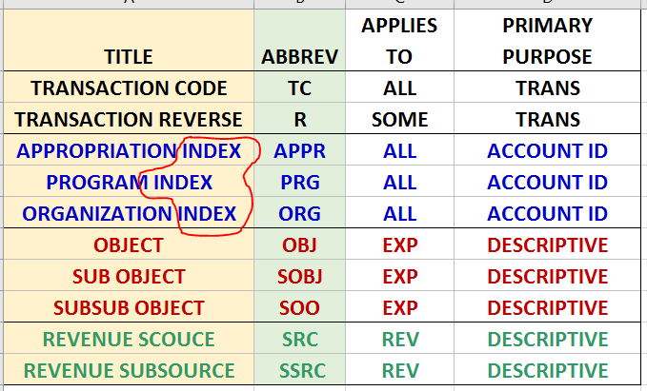
What’s an INDEX anyway?

Slide 23
What’s an INDEX anyway?
A field (column) of data intentionally designed/defined and populated (filled) to enable us to quickly:
  Search
  Sort
  Group
  Aggregate (Sum)
  Compare
Based on our understanding of the data element (the data in the Index itself), and the question we are trying to answer.

Slide 24
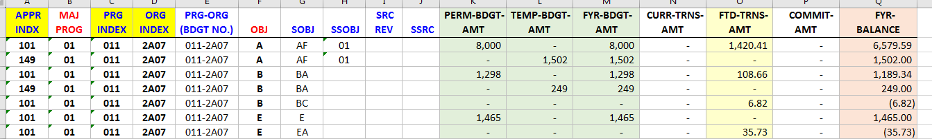
What’s an INDEX anyway?
A BRIEF DEMO:

Slide 25
Primary Account Structure Elements
& Their Abbreviations

Slide 26
Account Structure
Elements and Abbreviations laid out in the generally accepted order of use.
TRANSACTION CODE | TRANS REVERSE | APPROPRIATION INDEX | PROGRAM INDEX | ORGANIZATION INDEX | OBJECT | SUB OBJECT | SUB SUB OBJECT | REVENUE SOURCE | REVENUE SUB SOURCE
TC | R | APPR | PRG | ORG | OBJ | SOBJ | SSO | SRC | SSRC

Slide 27
– Forms in which we use the Account Structure –
eForms,ENSRC, Invoice Voucher, Purchase Req, Travel Req, IDC, etc.
&
FMS Query

Slide 28
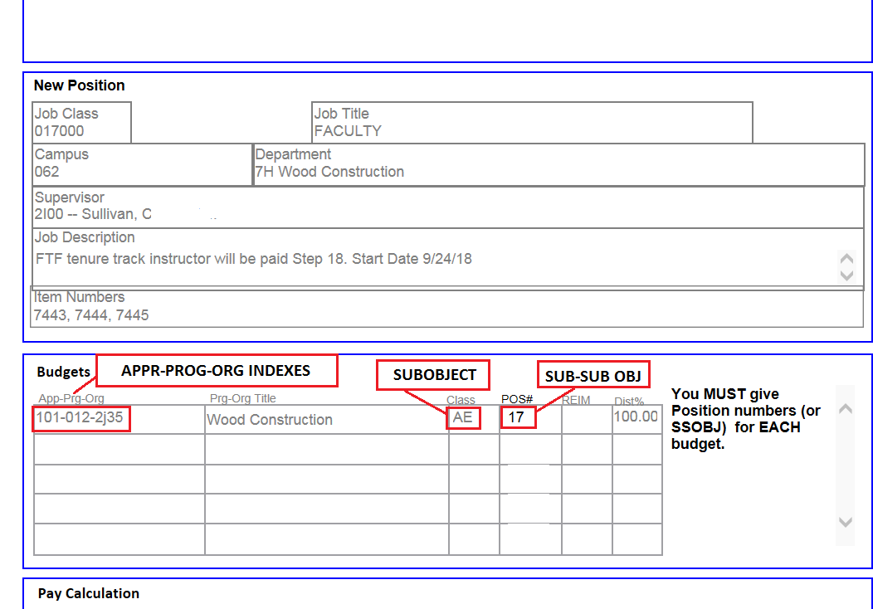
eForms Budget Section:

Slide 29
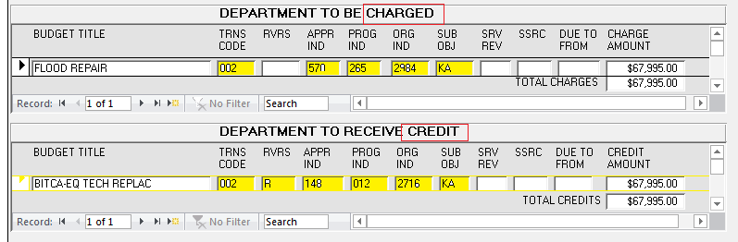
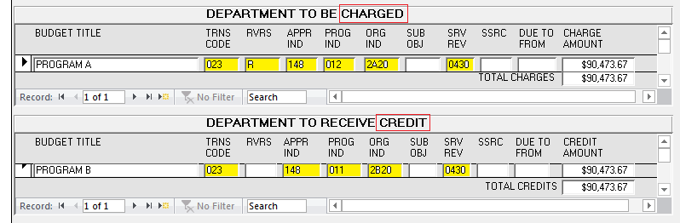
IDC CHARGE AND CREDIT SECTIONS:
EXPENDITURE TRANSFER CODING
REVENUE TRANSFER CODING

Slide 30
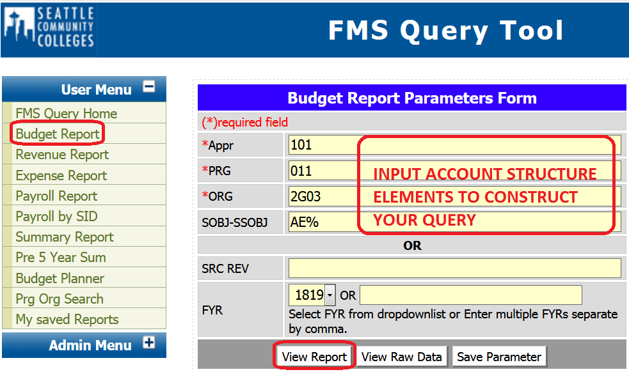
You Create a Query (Question) to FMSQ – by Inputting
Account Structure Elements

Slide 31
ACCOUNT STRUCTURE COMPONENTS
ONE-BY-ONE

Slide 32
TRANSACTION CODE (TC)
The Transaction Code tells the Accounting system what to do, by telling the system to make a specific entry (a Debit and a Credit) to specific accounting ledgers.
The TC is like the verb in a sentence – it determines what ACTION the accounting system should take.
We’ll come back to this in a short exercise.

Slide 33
Appropriation Index
This continues our earlier discussion of Funds and Fund Accounting.

Slide 34
Each of the Accounting Funds has a Code and a Name
The 3 Digit Code is Called the Appropriation Index

Slide 35
The Appr Index Tells the System:
What container we are trying to funnel our accounting (transaction) record into.
The general source of the funding we will be receiving/using.
If there are specific rules that apply to its use, we can find out by way of the Appr.
It’s the “great dot connector” that puts charges on our budget into the right container (and taps the right funding source).

Slide 36
APPROPRIATION INDEXES: Working List
APPR INDX | FUNDING SOURCE | TYPE OF MONEY | HOW WE RECEIVE IT
101 | STATE APPROPRIATION | STATE | REIMBURSEMENT
149 | TUITION REVENUE | STATE | REVENUE
145 | GRANTS & CONTRACTS | PUBLIC | REVENUE
148 | SELF-SUPPORT | PUBLIC | REVENUE
522 | S&A FEES | PUBLIC | REVENUE
524 | BOOKSTORE | PUBLIC | REVENUE
528 | PARKING | PUBLIC | REVENUE
569 | FOOD SERVICES | PUBLIC | REVENUE
570 | ENTERPRISE | PUBLIC | REVENUE
840 | AGENCY | FEDUCIARY | “DONATION”
846 | FINANCIAL AID | PROPRIETARY | VARIES

Slide 37
APPR INDEXES : Example College Programs
101 | STATE APPROPRIATION |  | 148 | SELF SUPPORT |  | 569 | FOOD SERVICES
 | STATE OPERATING BUDGETS |  |  | ALL LAB FEES |  |  | FOOD SERVICES
 |  |  |  | UTF
123 | WORKER RETRAINING |  |  | E LEARNING |  | 570 | ENTERPRISE
 | STATE OPERATING BUDGETS |  |  | MAC |  |  | INTENSIVE ENGLISH PROG
149 | TUITION REVENUE |  |  |  |  |  | FACILITIES RENTALS
 | STATE OPERATING BUDGETS |  | 448 | PRINTING FUND |  |  | OTHER RENTALS
145 | GRANTS & CONTRACTS |  | 460 | MOTOR POOL |  | 840 | AGENCY
 | INTL STUDENT PROGRAMS |  |  |  |  |  | VARIOUS
 | ALL FEDERAL GRANTS |  | 522 | S&A FEES
 | ALL STATE GRANTS |  |  | ALL STUDENT PROGRAMS |  | 846 | FINANCIAL AID
 | ALL OTHER GRANTS |  |  |  |  |  | VARIOUS
 | ALL CONTRACTS |  | 524 | BOOKSTORE
 |  |  |  |  |  | 849 | STUDENT LOAN
147 | LOCAL CAPITAL PROJECTS
 |  |  | 528 | PARKING |  | 850 | WORK STUDY

Slide 38
Program Index (PRG)
The Program Index identifies what program within the colleges operations is involved in the transaction.
There are two pieces –
the Major Program (first two digits) and
the Sub Program (third digit)
----------------------------------------------------------------------
Example: “011”
Major Program is 01 “Instruction”
Sub Program is __1 “Academic Instruction for credit only”

Slide 39
Major Program Index Examples

Slide 40
PROGRAM INDEX: EXAMPLES

Slide 41
ORGANIZATION INDEX (ORG)
The Organization Index identifies the Campus, and Department (to a certain degree)
The combination of your Program Index and Organization Index is you Budget Number
That combination is unique in the SCD District - there is only one such combination in the accounting and budget systems

Slide 42
ORG INDEX: FIRST CHARACTER CONVENTION
ORG INDX - FIRST CHARACTER | DESCRIPTION
A | DISTRICT OFFICE OPS
1 | DISTRICT-WIDE OPS
2 | CENTRAL
3 | NORTH
4 | SOUTH
5 | SVI
BUDGET NUMBER EXAMPLE: 011-3G03
Structure | PRG INDX | ORG INDEX
Code | 011 | 2 | G03
Translation | Instruction- Credit Programs | Central Campus | Humanities

Slide 43
An Analogy You Might Try, to help remember construct - Think Area Code and Phone Number:
APPR PROG-ORG
148 011-2708
AREA CODE PHONE-NUMBER
206 934-5660
As we’ll see in a minute, you need to remember to “dial in” the right APPR to transact correctly.

Slide 44
Expenditure Objects are Descriptive
OBJECT (OBJ) | OBJECT TITLE (DESCRIPTION)
A | SALARIES
B | BENEFITS
C | CONTRACTED SERVICES
E | GOOD & SERVICES
G | TRAVEL
J | EQUIPMENT
K | COMPUTER EQUIPMENT
N | CLIENT SERVICES
P | LEASES
S | INTER-AGENCY REIMBURSEMENTS
T | INTRA-AGENCY REIMBURSEMENTS
Object level is used more in Budget Plans, and in summarizing data than in recording transactions

Slide 45
Add a Second Character (Sub-Object), and the Description becomes more Detailed
Object | Sub –Object | SubObject Level | DESCRIPTION
E | _ | E | GOODS & SERVICES
E | A | EA | SUPPLIES & MATERIALS
E | B | EB | COMMUNICATIONS
E | C | EC | UTILITIES
E | D | ED | RENTALS & LEASES
E | E | EE | REPAIRS/ALTER/MAINT
E | F | EF | PRINTING & REPRODUCT
E | G | EG | EDUCATION & TRAINING
E | J | EJ | SUBSCRIPTIONS
E | K | EK | FACILITIES & SERVICE
E | L | EL | DATA PROCESSING SRVC
E | M | EM | ATTORNEY GENERAL SRV
E | N | EN | PERSONNEL SERVICES
E | P | EP | INSURANCE
E | R | ER | PURCHASED SERVICES

Slide 46
Account Structure Elements
Expenditure Transaction w/o Structure:
0021480112700EG $125.00
Transaction with Structure:
002 |  | 148 | 011 | 2700 |  | EG
TC | R | APPR | PRG | ORG | OBJ | SOBJ | SSO | SRC | SSRC
Translation: An expenditure transaction in the self-support fund, budget 011-2700, for registration fees in the amount of $125.00
Notes:
Like a routing number (we have them for both Expenditures and Revenues)

Slide 47
Account Structure Elements (fill in the blanks)
Expenditure Transaction w/o Structure:
0021480112700EG $125.00
Transaction with Structure:
TC | R | APPR | PRG | ORG | OBJ | SOBJ | SSO | SRC | SSRC
Translation: An expenditure transaction in the self-support fund, budget 011-2700, for registration fees in the amount of $125.00
Notes:
Like a routing number (we have them for both Expenditures and Revenues)

Slide 48
Revenue Source Codes (SRC)
Revenue Source code tells us exactly that – the source of the revenue received.
And, to a certain degree, tells us something about how the money should be used.
Examples:
0424 – Tuition Revenue
0430 – Dedicated Student Fee (e.g. lab fees)

Slide 49
SRC REV Examples
SRC REV | DESCRIPTION
0384 | DEPT OF EDUCATION
0402 | INCOME FROM PROPERTY
0424 | TUITION & FEES
0430 | DEDICATED STUDENT FEES
0485 | IMMATERIAL ADJ-PRIOR
0499 | OTHER REVENUE
0541 | CONTRIBUTIONS & GRANTS
0542 | LOCAL GOV CONTR/GRNT
0543 | ST GOVE CONTR/GRANT
0621 | FUND TRANSFERS - IN
0622 | FUND TRANSFERS - OUT
0782 | INTRA-FUND TRANSFER
0999 | OPENING ENTRIES

Slide 50
Revenue SubSource (SSRC)
The SSRC helps us separate the revenue sources more exactly.
The SSRC is “tied” to the Revenue Source (SRC) and to individual budgets.
The SSRC is also known as FEE CODE (they are the same thing).

Slide 51
Revenue Transaction w/o Structure:
02314801127000430HR $70.00
Transaction with Structure:
023 |  | 148 | 011 | 2700 |  |  |  | 0430 | HR
TC | R | APPR | PRG | ORG | OBJ | SOBJ | SSO | SRC | SSRC
Translation: An revenue transaction in the self-support fund, budget 011-2700, for dedicated student fee, Electronics Lab - in the amount of $70.00

Slide 52
REV Transaction: Fill in the Blanks
Revenue Transaction w/o Structure:
02314801127000430HR $70.00
Transaction with Structure:
TC | R | APPR | PRG | ORG | OBJ | SOBJ | SSO | SRC | SSRC
Translation: An revenue transaction in the self-support fund, budget 011-2700, for dedicated student fee, Electronics Lab - in the amount of $70.00

Slide 53
Expenditure Trans
002 |  | 148 | 011 | 3700 |  | EG
Transaction Code | Trans Reverse | Appropriation Index | Program Index | Organization Index | Object | Sub Object | SubSub Object | Revenue Source | Revenue SubSource
TC | R | APPR | PRG | ORG | OBJ | SOBJ | SSO | SRC | SSRC
Revenue Trans
023 |  | 148 | 011 | 3700 |  |  |  | 0430 | HR
Transaction Code | Trans Reverse | Appropriation Index | Program Index | Organization Index | Object | Sub Object | SubSub Object | Revenue Source | Revenue SubSource
TC | R | APPR | PRG | ORG | OBJ | SOBJ | SSO | SRC | SSRC

Slide 54
This is important to remember….
Budget is Your Plan
Accounting is Reality

Slide 55
Your Budget is the result of constructing your plan to spend money. When put online, your budget also represents an approval to spend and its limits.

Slide 56
The Accounting Record (of revenue and expenditure transactions) displays the reality of what has actually happened.

Slide 57
Generally speaking….
we have two types of “fiscal reports”:
Budget Status Reports – reports that combine Budget (Plan) with summarized (added up) data from Accounting (Reality) transaction-by-transaction detail reports.
Accounting Only Reports - detail revenue and expenditure reports (including Payroll reports) that contain transaction-by-transaction records of what has happened (i.e. ground level view).

Slide 58
FMS Query 17-18 Budget Report
APPR | PRG-ORG | SOBJ SSOB | SRC REV | DESCRIPTION | PERM BDGT | TEMP BDGT | FISCAL YR BDGT | EXP/REV AMOUNT | ENCUMB AMT | BALANCE
149 | 0432J00 | AB01 |  | PERY, JACQUELINE | 75,589 | 0 | 75,589 | 55,752.44 | 0 | 19,836.56
149 |  | AC99 |  | VARIES | 0 | 45,578 | 45,578 | 18,383.58 | 0 | 27,194.42
149 |  | AD01 |  | VARIOUS | 1,886 | 0 | 1,886 | 768.94 | 0 | 1,117.06
101 |  | AK04 |  | GUY, GEORGE B | 45,828 | 0 | 45,828 | 21,768.32 | 0 | 24,059.68
101 |  | AK05 |  | TIANT, LUIS | 19,758 | 0 | 19,758 | 13,995.25 | 0 | 5,762.75
101 |  | AK06 |  | KOEPCKE, JULIANNE | 39,516 | 0 | 39,516 | 21,939.60 | 0 | 17,576.40
101 |  | AK07 |  | HART, BETH | 35,040 | 0 | 35,040 | 22,906.86 | 0 | 12,133.14
101 |  | AK10 |  | MCNEISH, CHIPPY | 38,556 | 0 | 38,556 | 26,346.62 | 0 | 12,209.38
101 |  | AK11 |  | SUNDQVIST, WILLE | 37,404 | 0 | 37,404 | 24,820.00 | 0 | 12,584.00
149 |  | AM01 |  | VARIOUS | 10,540 | 0 | 10,540 | 16,546.90 | 0 | -6,006.90
Object: A Total: |  |  |  |  | 304,117 | 45,578 | 349,695 | 223,228.51 | 0 | 126,466.49
149 | 0432J00 | BA |  | OASI | 23,652 | 14,422 | 38,074 | 7,255.38 | 0 | 30,818.62
101 |  | BA |  | OASI | 84,078 | 0 | 84,078 | 9,776.27 | 0 | 74,301.73
101 |  | BB |  | RETIREMENT & PENSION | 0 | 0 | 0 | 12,193.22 | 0 | -12,193.22
149 |  | BB |  | RETIREMENT & PENSION | 0 | 0 | 0 | 7,203.87 | 0 | -7,203.87
149 |  | BC |  | MED AID & IND INS | 0 | 0 | 0 | 806.05 | 0 | -806.05
101 |  | BC |  | MED AID & IND INS | 0 | 0 | 0 | 1,312.44 | 0 | -1,312.44
101 |  | BD |  | HEALTH LIFE & DISAB | 0 | 0 | 0 | 33,672.90 | 0 | -33,672.90
149 |  | BD |  | HEALTH LIFE & DISAB | 0 | 0 | 0 | 13,059.40 | 0 | -13,059.40
Object: B Total: |  |  |  |  | 107,730 | 14,422 | 122,152 | 85,279.53 | 0 | 36,872.47
149 | 0432J00 | E |  |  | 5,725 | 0 | 5,725 | 0.00 | 0 | 5,725.00
149 |  | EA |  | SUPPLIES & MATERIALS | 0 | 0 | 0 | 2,602.46 | 0 | -2,602.46
149 |  | EF |  | PRINTING & REPRODUCT | 0 | 0 | 0 | 1,126.52 | 0 | -1,126.52
149 |  | EG |  | EDUCATION & TRAINING | 0 | 0 | 0 | 880.00 | 0 | -880.00
Object: E Total: |  |  |  |  | 5,725 | 0 | 5,725 | 4,608.98 | 0 | 1,116.02
149 | 0432J00 | G |  |  | 2,565 | 0 | 2,565 | 0.00 | 0 | 2,565.00
149 |  | GC |  | PRIVATE AUTO MILEAGE | 0 | 0 | 0 | 553.42 | 0 | -553.42
149 |  | GD |  | OTHER TRANSPORTATION | 0 | 0 | 0 | 150.86 | 0 | -150.86
149 |  | GF |  | OUT-OF-ST SUB&LODGIN | 0 | 0 | 0 | 818.44 | 0 | -818.44
149 |  | GG |  | OUT-OF-ST AIR TRANS | 0 | 0 | 0 | 1,033.60 | 0 | -1,033.60
Object: G Total: |  |  |  |  | 2,565 | 0 | 2,565 | 2,556.32 | 0 | 8.68
PRG_ORG: EXAMPLE BGT 17-18 Total: |  |  |  |  | 420,137 | 60,000 | 480,137 | 315,673.34 | 0 | 164,463.66
FYR (17-18) Total: |  |  |  |  | 420,137 | 60,000 | 480,137 | 315,673.34 | 0 | 164,463.66
Grand Total: |  |  |  |  | 420,137 | 60,000 | 480,137 | 315,673.34 | 0 | 164,463.66

Slide 59
FMSQ 17-18 Budget Rpt with Columns Identified

Slide 60
FMSQ 17-18 Budget Only (w/o Transaction & Balance Columns)

Slide 61
FMSQ 17-18 Budget Columns ONLY

Slide 62
The next segment pertains to what we call “Revenue Budgets”, which are for programs that receive revenues directly for services provided.
(e.g., Int’l Programs, Continuing Educ, S&A Programs, Lab Fees, the MAC, etc.)

Slide 63
Why + and Why -

Slide 64
Why + and Why -

Slide 65
Why + and Why -
This an “Accounting Thing”
The system differentiates between Debits and Credits by using positive (+) and negative (-) values
Debits are recorded as positives +
Credits are recorded as negatives –
This enables us to quickly tell if we are in balance

Slide 66
Debits are recorded as positives +
Credits are recorded as negatives –
This enables us to quickly tell if we are in balance
Increases in Expenditure are recorded as Debits (+ values)
Increases in Revenues are recorded as Credits (– values)
When Expenditures Equal Revenues, the sum is Zero

