Slide 1

Institutional
Finance$ and FUNds
College Council Resource Allocation Subcommittee

Slide 2

Agenda and Outcomes
Operating budget overview
State appropriation and system allocation
State funding and enrollment trends
FY 18-19: Additional context and district priorities
Questions & Answers

Slide 3


The Big Picture
Instruction
International Programs
Parking
Foundation Funded
Professional Development
Grant Funded
Scholarships
Self Support & Enterprise
Student Services
Administrative Services
Institutional Management
Auxiliary Services – Food, Copy, Rent
National Science Foundation
Carl D. Perkins
WorkFirst
Operating Budget
Capital Budget
Minor & Major Projects
Repair & Program Improvement
M&O Funding
Department of Education

Slide 4
16 – 17 Revenue Budget vs Actual
Revenue Source | FY17 Forecast | FY17 Actual | Year-end %
Operating Fee (tuition) | $10,415,682 | $10,215,682 | 98%
S&A Fee | $1,127,000 | $1,315,889 | 117%
Technology Fee | $576,962 | $587,060 | 102%
Running Start | $1,319,893 | $1,813,879 | 137%
International | $18,896,754 | $19,341,583 | 102%
eLearning | $115,382 | $127,057 | 110%
Continuing Education | $255,472 | $292,264 | 114%
Auxiliary Services | $3,454,235 | $3,778,986 | 109%

Slide 5
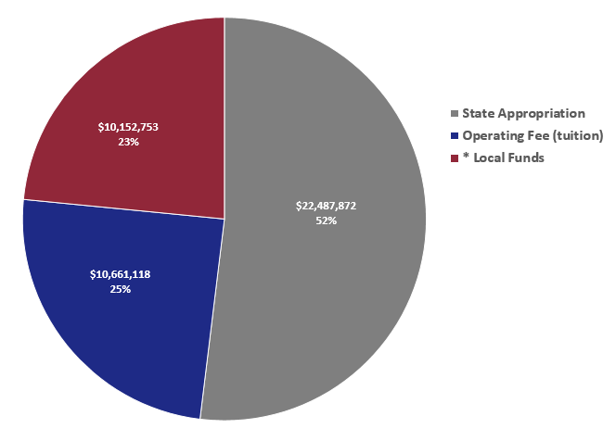
2017-18 Income by Funding Sources
* Running Start, International Programs, eLearning,
Foundation, and other enterprises

Slide 6

2017-18 Operating Budget
$4M operating budget based on:
FTE Assumptions:
  4,843 regular state-funded (compared to 4,989 in 16-17)
  680 Running Start (compared to 459 in 16-17)
  1,032 International Programs (compared to 1,114 in 16-17)
Basically overall flat enrollment
  Conservative approach
  Some growth in targeted disciplines/programs
2% increase in resident tuition

Slide 7
2017-18 Budgeted Funding Sources
Fund Source | 2016-2017 | 2017-2018
State Appropriation | $23,541,209 | $22,487,872
Operating Fee (tuition) | $10,215,682 | $10,661,118
Local Funds (Cost Recovery/Contract Funds from International and Running Start) | $10,013,614 | $10,152,753
Fund Reserves (IP Temp Allotment) | $2,500,000 | -
Carryforward (Net) | $3,572,505 | $ 4,468,520
TOTAL ALLOCATION | $49,843,011 | $47,770,263
Total Expenditures | $44,931,005
Operating Balance (Carryforward (gross)) | $4,882,006

Slide 8
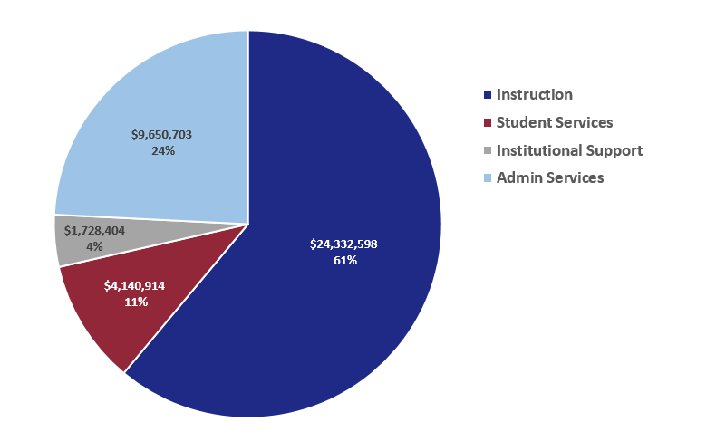
Seattle Central
2017-18 Expenditure by Cost Center

Slide 9
Agenda and Outcomes
Operating budget overview
State appropriation and system allocation
State funding and enrollment trends
FY 18-19: Additional context and district priorities
Questions & Answers

Slide 10


State Allocation Formula
  Minimum Operating Allowance (MOA)
  District Enrollment Allocation Base (DEAB=state FTE target)
  Student Achievement Initiative (SAI=performance funding)
  High priority (high demand) enrollment weighted FTE
  Provisos and earmarks
  Total District (College) Allocation

Slide 11

State Allocation Formula
  Minimum Operating Allowance (MOA)
  District Enrollment Allocation Base (DEAB)
  Student Achievement Initiative (SAI)
  High priority (high demand) enrollment weighted FTE
  Provisos and earmarks
  Total District (College) Allocation
E N R O L L M E N T

Slide 12
Agenda and Outcomes
Operating budget overview
State appropriation and system allocation
State funding and enrollment trends
FY 18-19: Additional context and district priorities
Questions & Answers

Slide 14
Seattle CPI Base Year: 2018
Washington Community and Technical College System
$ in thousands |  | Annual Expenditures in Constant Dollars* |  |  |  |  |  |  |  | Budgeted*
 | FY 2009 | FY 2010 | FY 2011 | FY 2012 | FY 2013 | FY 2014 | FY 2015 | FY 2016 | FY 2017 | FY 2018 | FY 2019
State Funds | 831,491 | 796,726 | 754,921 | 651,400 | 622,685 | 671,246 | 653,056 | 707,156 | 734,579 | 722,989 | 729,145
145 | 228,971 | 230,138 | 254,153 | 259,898 | 260,338 | 245,728 | 266,362 | 278,128 | 297,996 | 242,222 | 243,587
148 | 99,718 | 130,404 | 158,863 | 167,055 | 160,788 | 154,908 | 152,907 | 146,393 | 140,652 | 145,356 | 141,934
149 | 279,077 | 302,105 | 339,502 | 346,182 | 369,986 | 379,744 | 386,768 | 384,045 | 368,402 | 351,553 | 366,258
Total | 1,439,256 | 1,459,372 | 1,507,438 | 1,424,535 | 1,413,798 | 1,451,626 | 1,459,093 | 1,515,722 | 1,541,629 | 1,462,120 | 1,480,925
 | FY 2009 | FY 2010 | FY 2011 | FY 2012 | FY 2013 | FY 2014 | FY 2015 | FY 2016 | FY 2017 | FY 2018 | FY 2019
NGF-S | 58% | 55% | 50% | 46% | 44% | 46% | 45% | 47% | 48% | 49% | 49%
145 | 16% | 16% | 17% | 18% | 18% | 17% | 18% | 18% | 19% | 17% | 16%
148 | 7% | 9% | 11% | 12% | 11% | 11% | 10% | 10% | 9% | 10% | 10%
149 | 19% | 21% | 23% | 24% | 26% | 26% | 27% | 25% | 24% | 24% | 25%
Annual % Change in State Support |  | -3% | -5% | -4% | -2% | 2% | -1% | 2% | 1% | 2% | 0%
Cumulative % Change in State Support |  | -3% | -8% | -12% | -14% | -12% | -13% | -11% | -10% | -8% | -9%
 |  |  |  |  |  |  |  |  |  |  |  | Cumulative
Annual % Change in 145 |  | 0% | 1% | 1% | 0% | -1% | 1% | 0% | 1% | -3% | 0% | 1%
Annual % Change in 148 |  | 2% | 2% | 1% | 0% | -1% | 0% | -1% | -1% | 1% | 0% | 3%
Annual % Change in 149 |  | 1% | 2% | 2% | 2% | 0% | 0% | -1% | -1% | 0% | 1% | 5%
*Adjusted by Seattle CPI, Base Year 2018.

Slide 15
Seattle Central Enrollment Trends

Slide 16
Agenda and Outcomes
Operating budget overview
State appropriation and system allocation
State funding and enrollment trends
FY 18-19: Additional context and district priorities
Questions & Answers

Slide 17
Additional Context & Considerations
35% of the 2% COLA increase (-$265K)
Year 3 of the allocation model phase in (-684K)
2% tuition increase (+365K)
Increase in running start students ($+500K)
Increase in district office spending (-$310K)
One monthly payroll totals $3+ million
Major Institutional Master Planning update to 2001 plan
BAS Networking: year 2 implementation (-$232K)
Matching funds for underserved populations grants (-$200K)

Slide 18
District Strategic Initiatives
Goal 1: Student Success
Goal 2: Equity, Diversity, Inclusion, and Community
Goal 3: Organizational Excellence
Goal 4: Partnerships

Slide 19
Questions?
Thank you!

Slide 20
Budgeted Expenses vs Actual
Cost Center | 16-17 Budget | 16-17 Actual | Percent
Instruction | $23,802,968 | $29,000,866 | 122%
Student Services | $4,441,181 | $4,389,307 | 99%
Institutional Management | $2,007,625 | $1,916,203 | 95%
Administrative Services | $9,626,939 | $9,533,263 | 99%
Total Expenditures | $39,878,713 | $44,839,639 | 112%

Slide 21
Medium College Comparison
2017-18 Expenditures by Cost Center

Slide 22
Medium College Comparison
2017-18 Anticipated Funding Sources
* Running Start, International Programs, eLearning,
Foundation, and other enterprises

Slide 23
Questions from past presentations
What happens at Year end?
How do you represent your department to get more?
Why are some unit not (or why don’t some units feel) represented?

